Slide 1
Unsupervised Machine Learning
UMICH BIOINF595
Matthew O’Meara
2/18/2024

Slide 2
Opportunities for Machine learning in large scaled docking
Pose
prediction
Synthesis
prediction
Active
docking
Off target
prediction
Building blocks
Make-on- demand library
Large Scale Docking
QM/MD
Simulations
Structure activity relationship
Medicinal chemistry risks
Retrosynthesis
prediction
Generative
Design
Rescoring

Slide 3
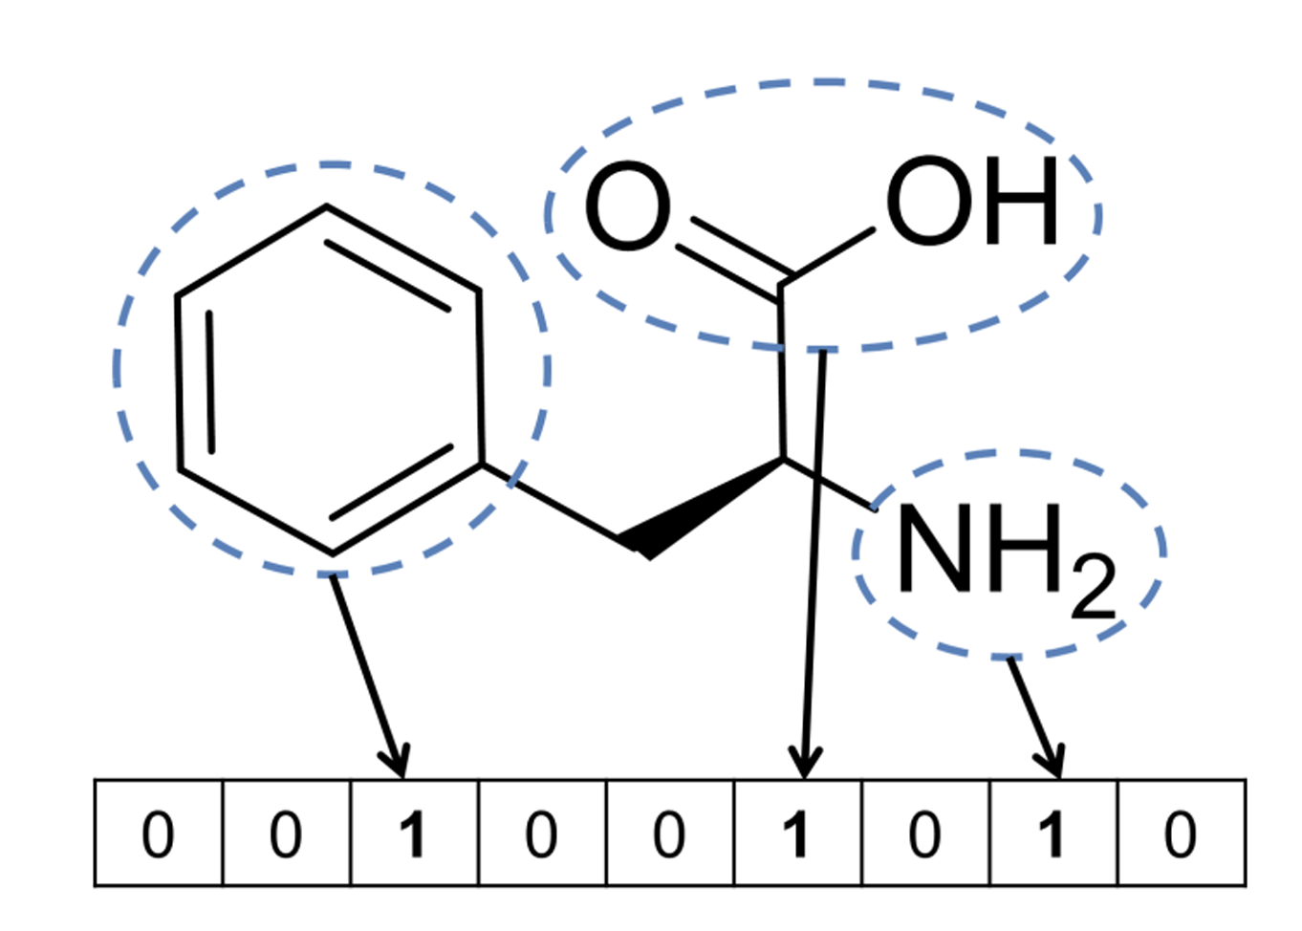
Fingerprint based machine learning
Active / Decoy
Label
Extended connectivity fingerprint (ECFP)
Molecule graph -> bit vector
Fingerprint
Predict
Compound
(Bajusz, et al., 2017)
(Rogers, Hahn, JCIM, 2010)

Slide 4
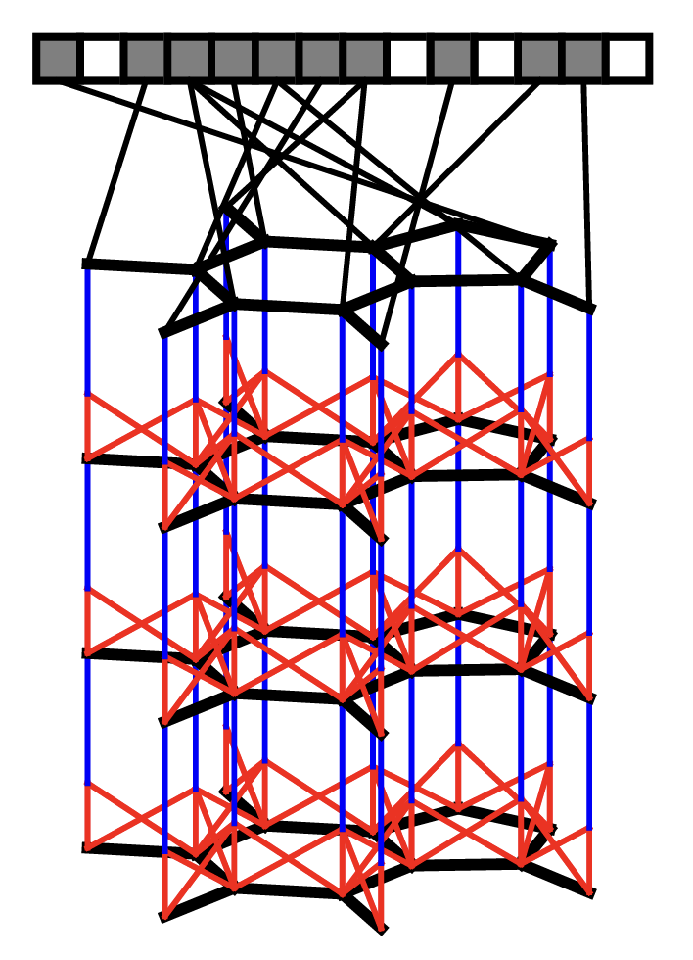
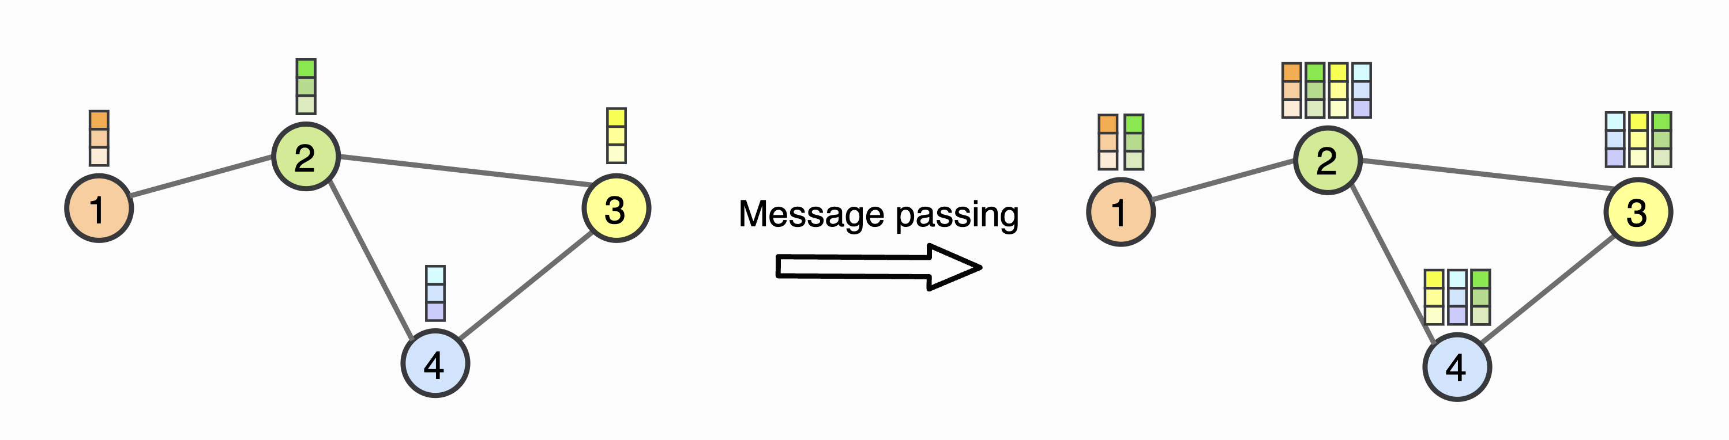
Graph Convolutional Network Similar to ECFP fingerprints but with learned weights
(Duvenaud, et al., 2015)

Slide 5
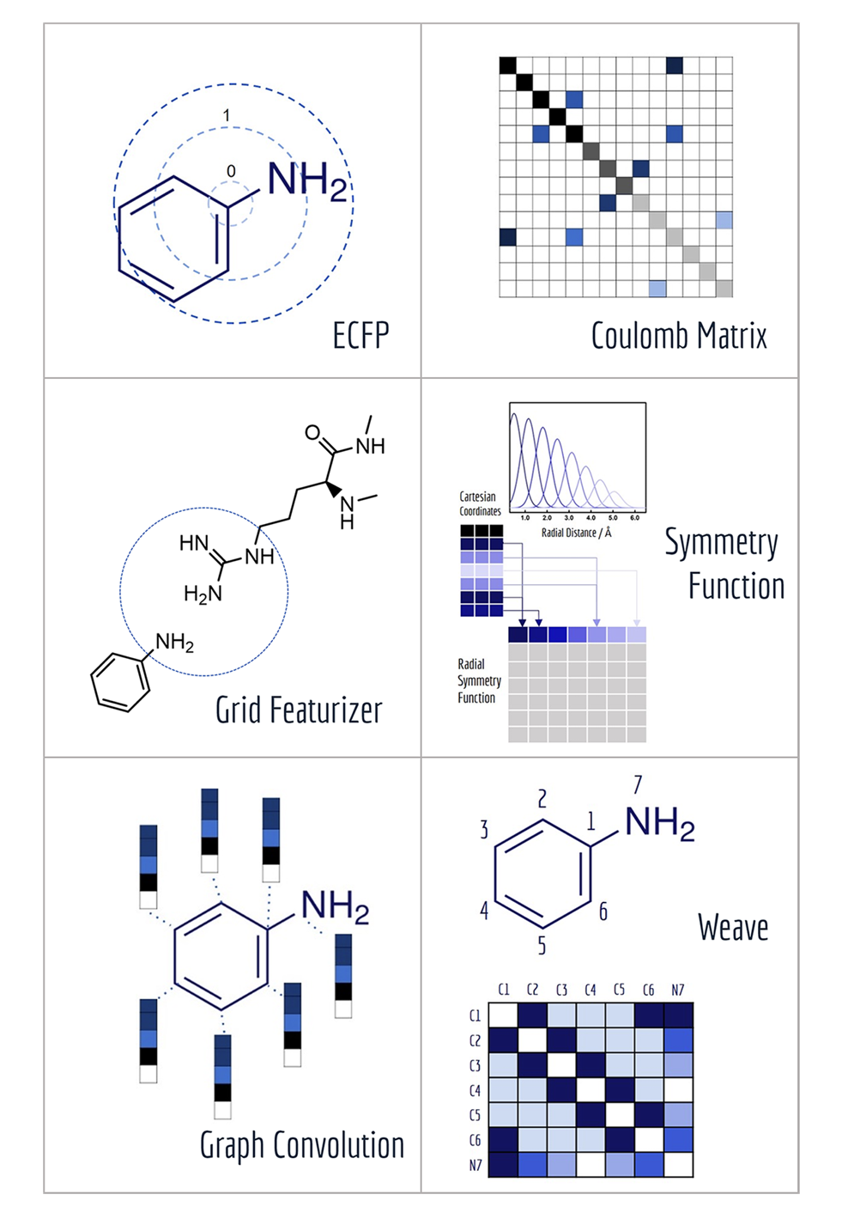
Featurization of molecules
DeepChem package
Good set of tools for building and testing ML form molecules
MoleculeNet is their testing benchmark/framework
(Wu, 2018)
Important to take handle symmetries of the data
Rotation/translation
Relabeling of atoms
=> E(3) space group
Notes:
MoleculeNet: A Benchmark for Molecular Machine Learning arXiv:1703.00564v3 [cs.LG] 26 Oct 2018
Zhenqin Wu,†,Bharath Ramsundar,‡,Evan N. Feinberg,¶,⊥ Joseph Gomes,†,⊥ Caleb Geniesse,¶ Aneesh S. Pappu,‡ Karl Leswing,§ and Vijay Pande∗,
https://arxiv.org/abs/1703.00564

Slide 6
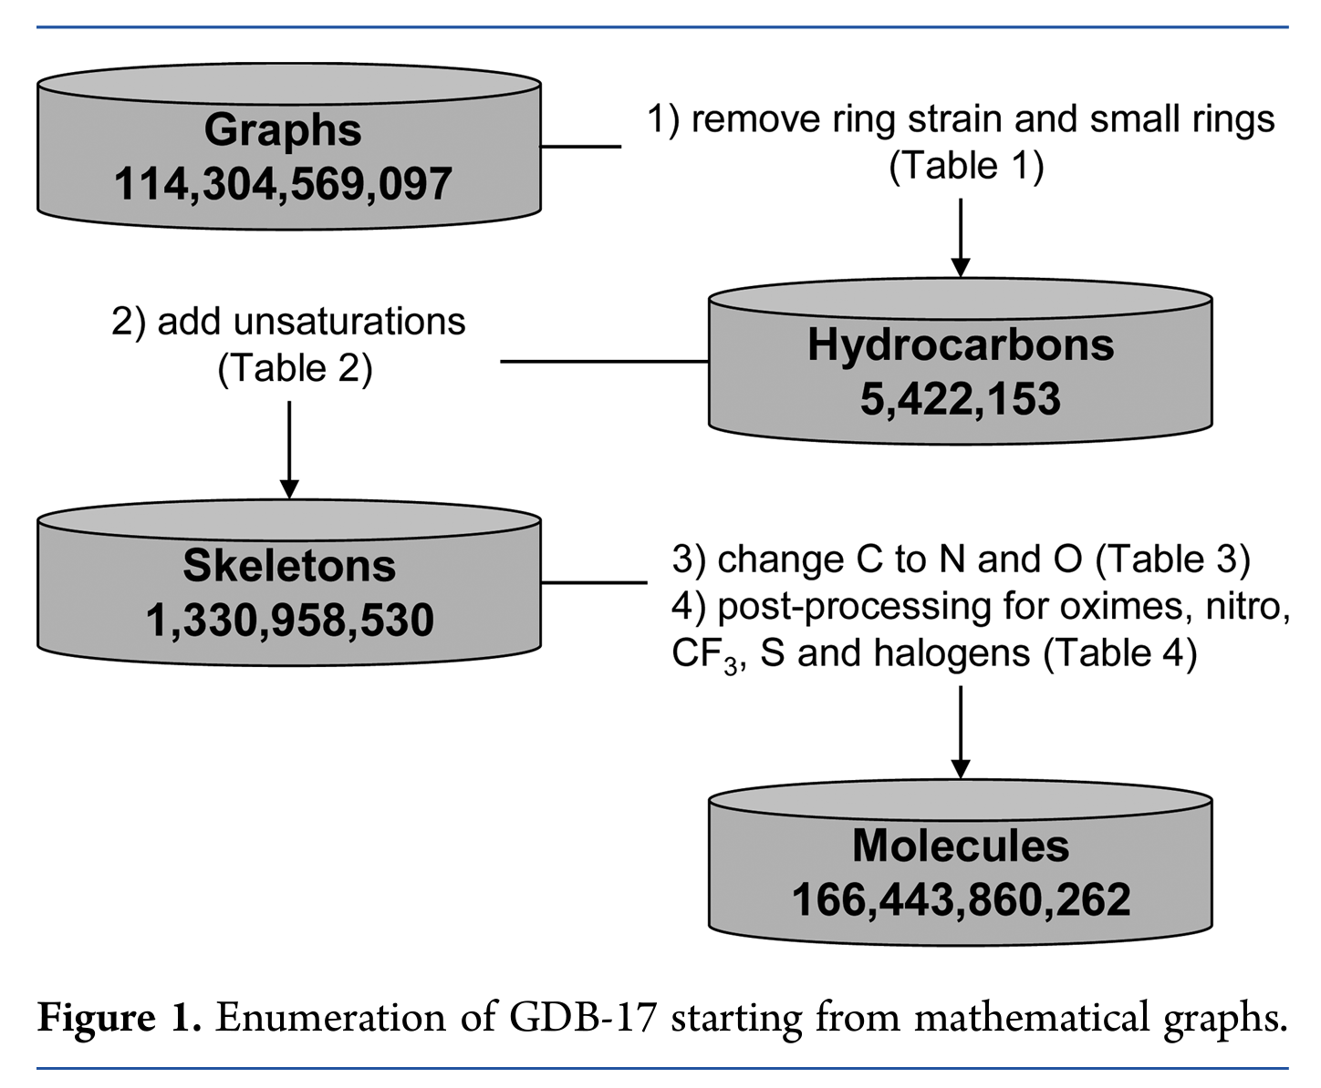
QM9 (Quantum Machines 9) dataset
GDB-17: Enumeration of 166 Billion
Organic Small Molecules
QM9
All molecules up to 9 heavy atoms
133,885 molecules
Minimized geometry
Quantum chemistry properties
(Ruddigkeit, et al., 2012)
(Ramakrishnan, et al., 2014)

Slide 7
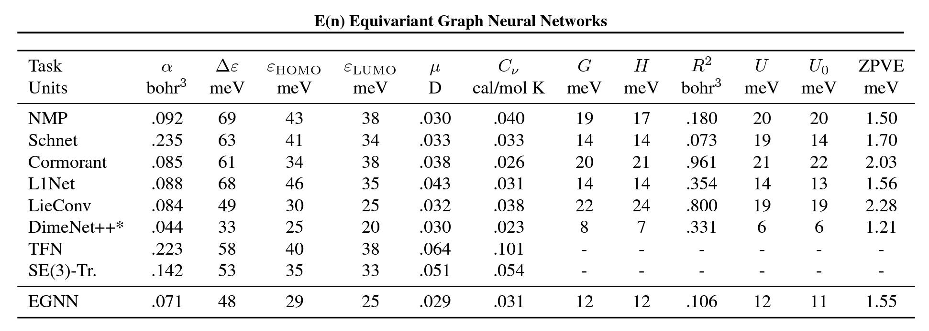
E(3) Equivariant Network state of the art on QM9

Slide 8
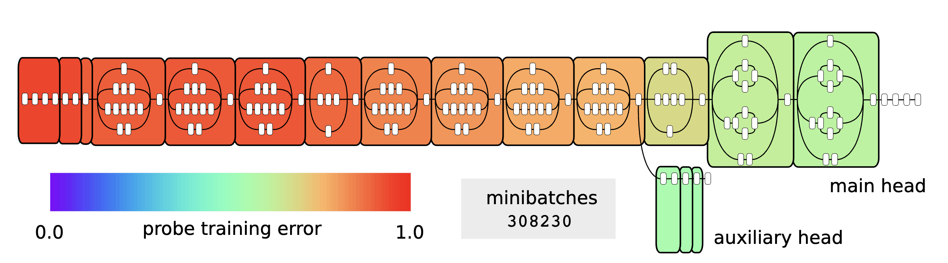
Linear projection: tool for assessing linear seprability of representations
Notes:
Inception v3 model after 2 weeks of training. Red is bad (high prediction error) and
green/blue is good (low prediction error). The smooth color gradient shows a very gradual transition
in the degree of linear separability (almost perfectly monotonic).
https://arxiv.org/pdf/1610.01644
[Submitted on 5 Oct 2016 (v1), last revised 22 Nov 2018 (this version, v4)]
Understanding intermediate layers using linear classifier probes
Guillaume Alain, Yoshua Bengio

Slide 9
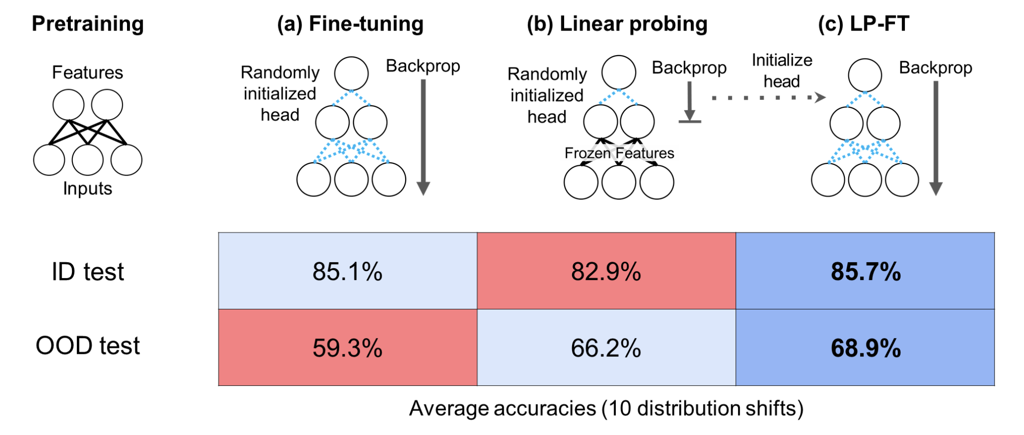
How to use supervised models for multiple tasks?
Notes:
Fine-Tuning can Distort Pretrained Features and Underperform Out-of-Distribution
Ananya Kumar, Aditi Raghunathan, Robbie Jones, Tengyu Ma, Percy Liang
https://arxiv.org/abs/2202.10054

Slide 10
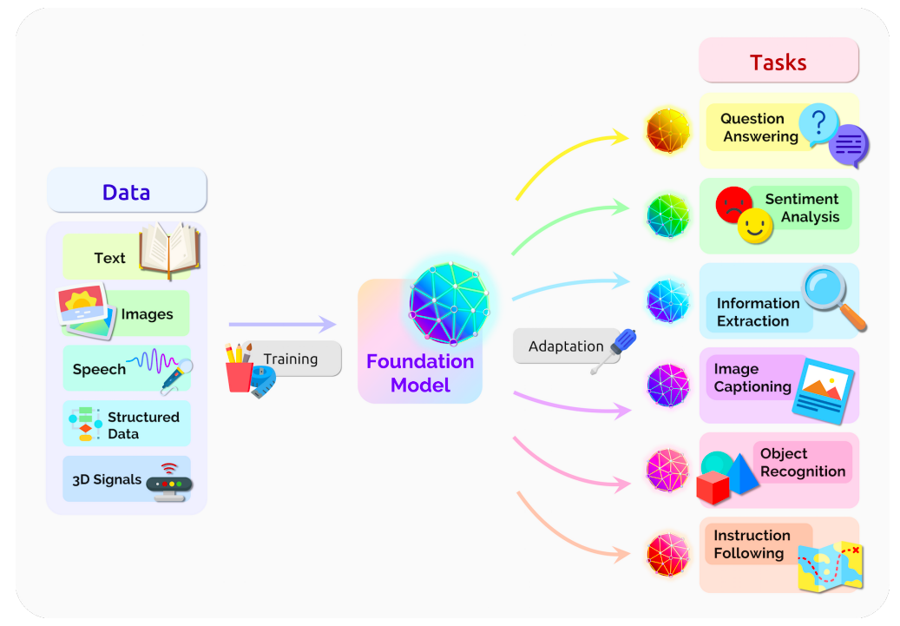
Foundation Model
(Bommasani, et al., 2021)

Slide 11
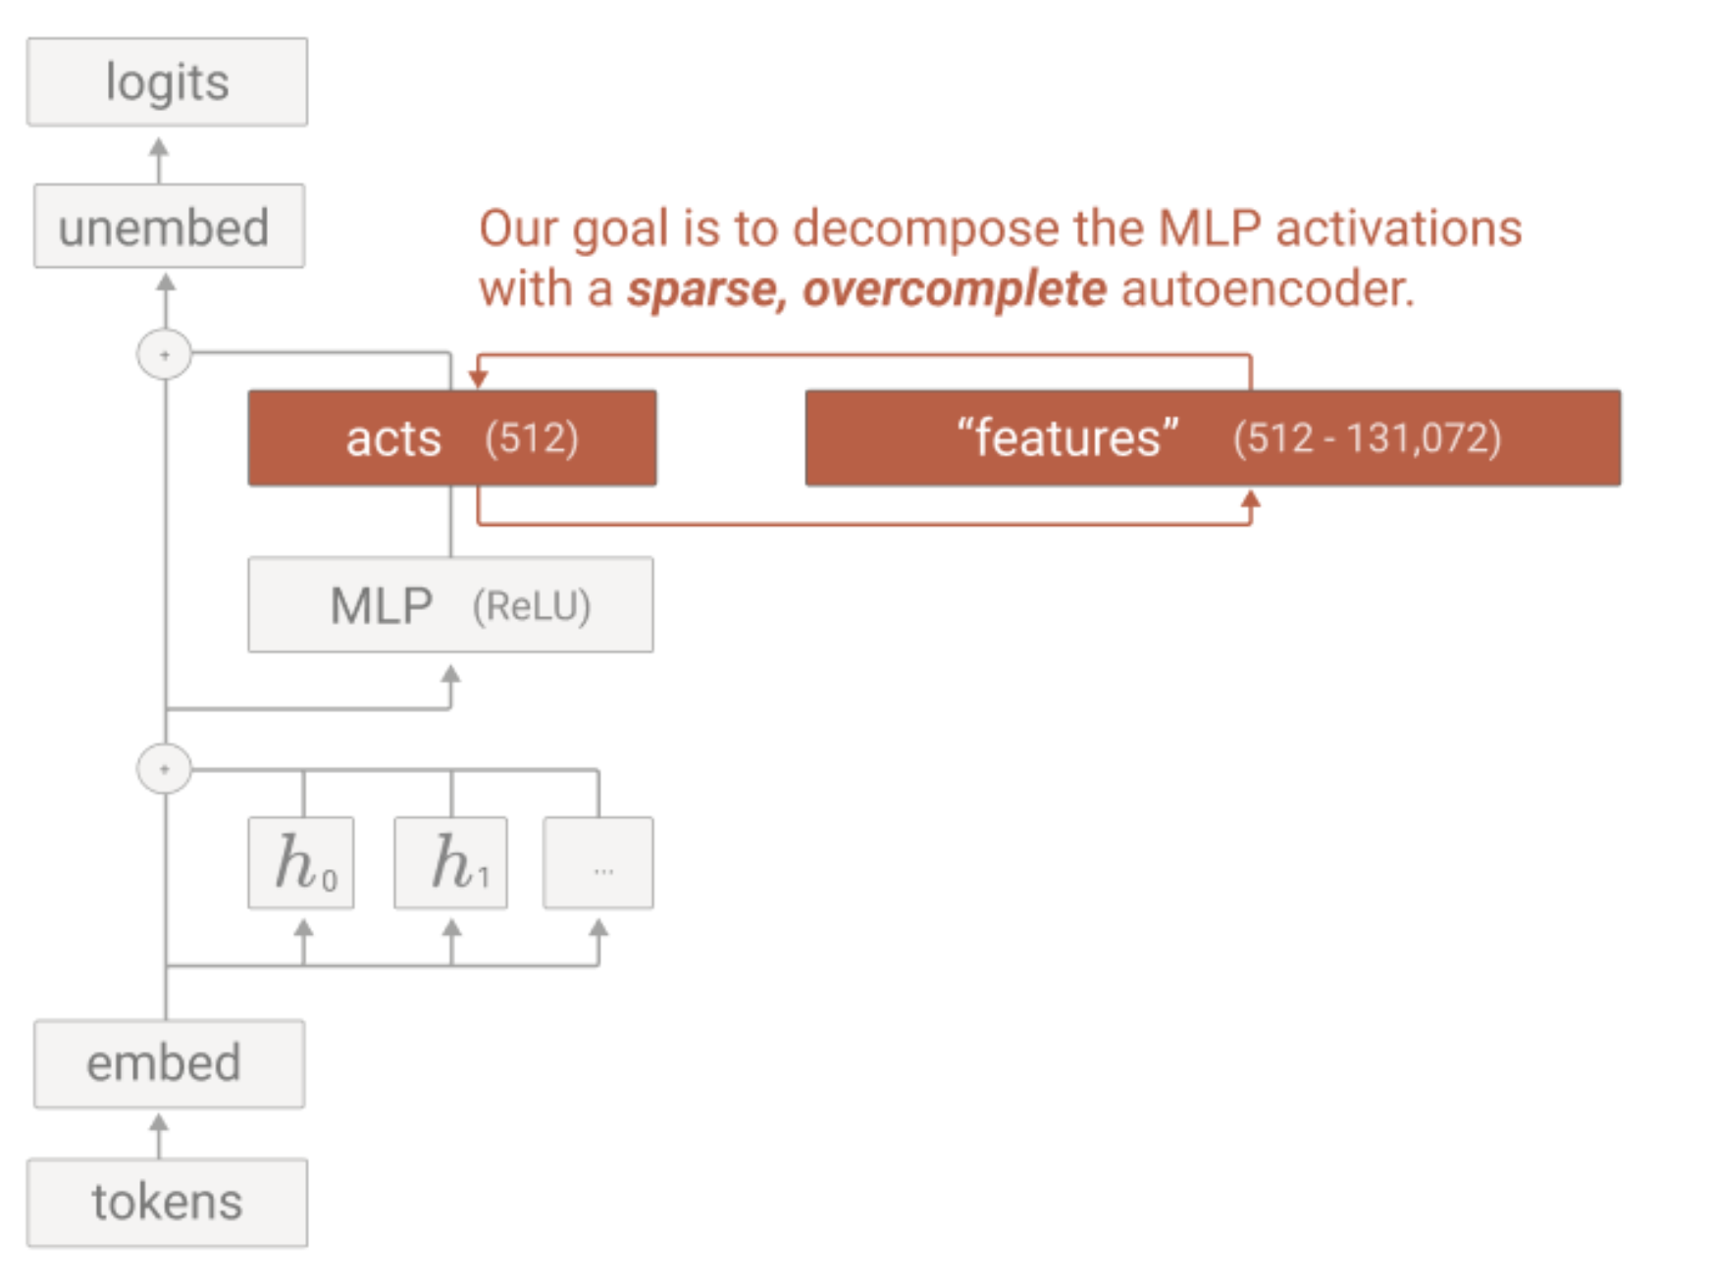
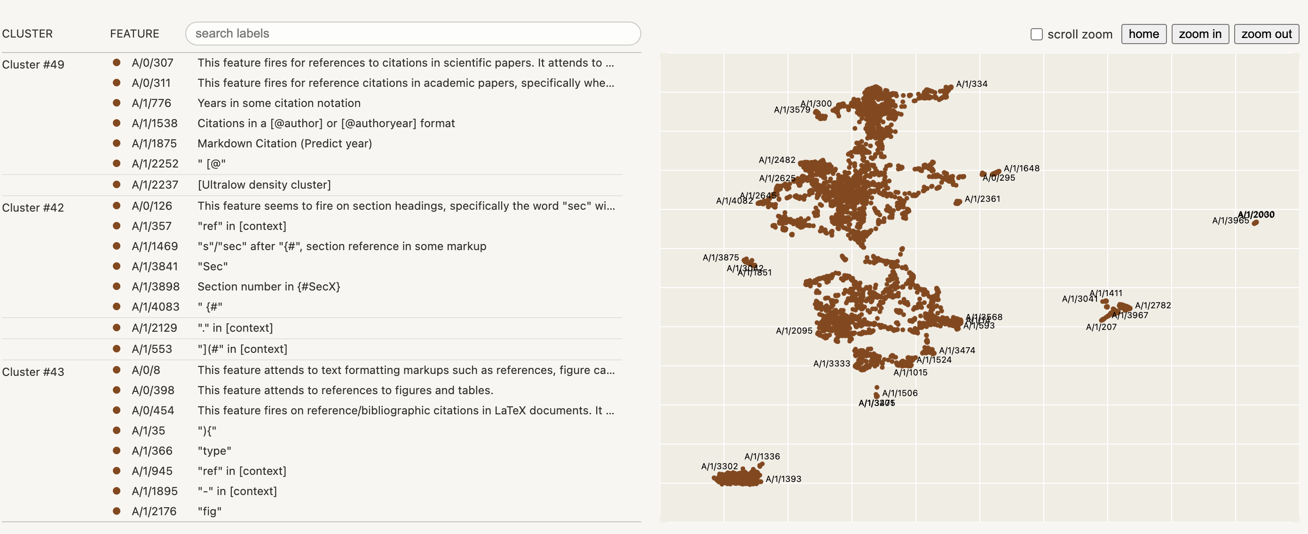
Representations can be “multiplexed” in the latent space Spare autoencoders can be used pick out concepts
Notes:
https://transformer-circuits.pub/2023/monosemantic-features

Slide 12
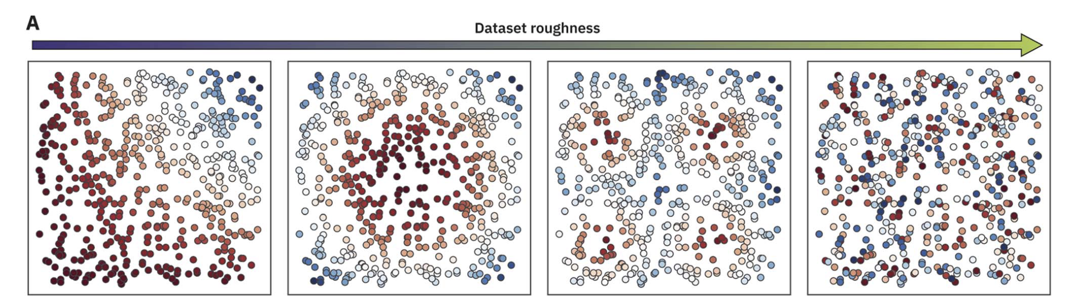
Good representations are smooth
Notes:
Evaluating the roughness of structure–property relationships using pretrained molecular representations†
David E. Graff, Edward O. Pyzer-Knapp, Kirk E. Jordan, d Eugene I. Shakhnovich and Connor W. Coley
Digital Discovery, 2023, 2, 1452

Slide 13
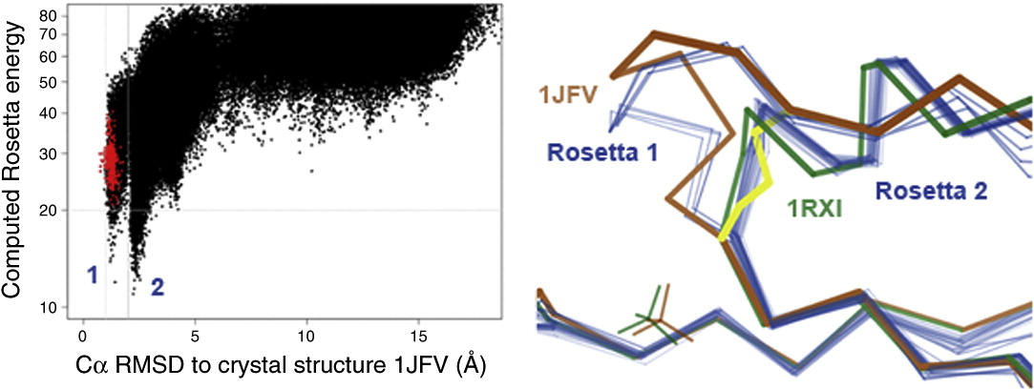
Energy landscape for proteins are very rugged

Slide 14
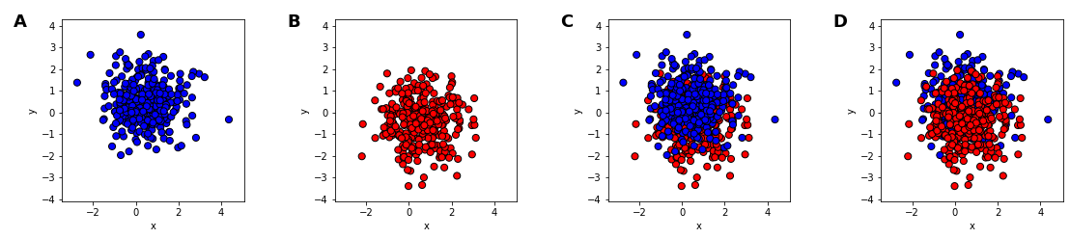
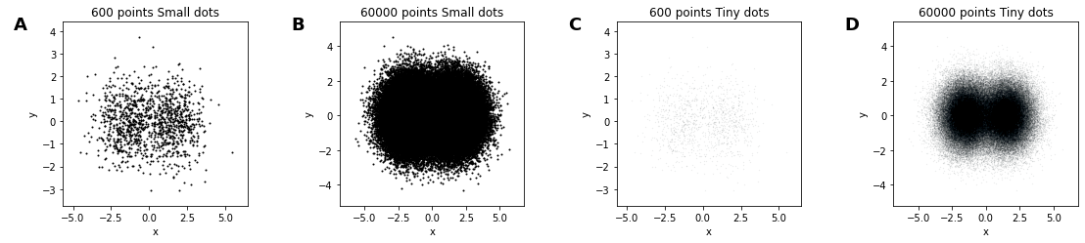
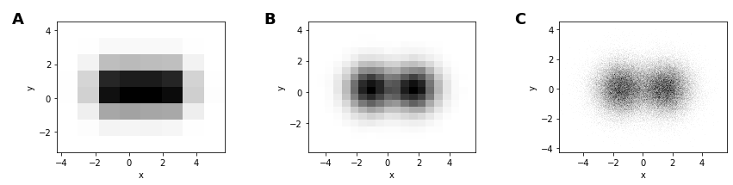
How to handle overplotting?

Slide 15
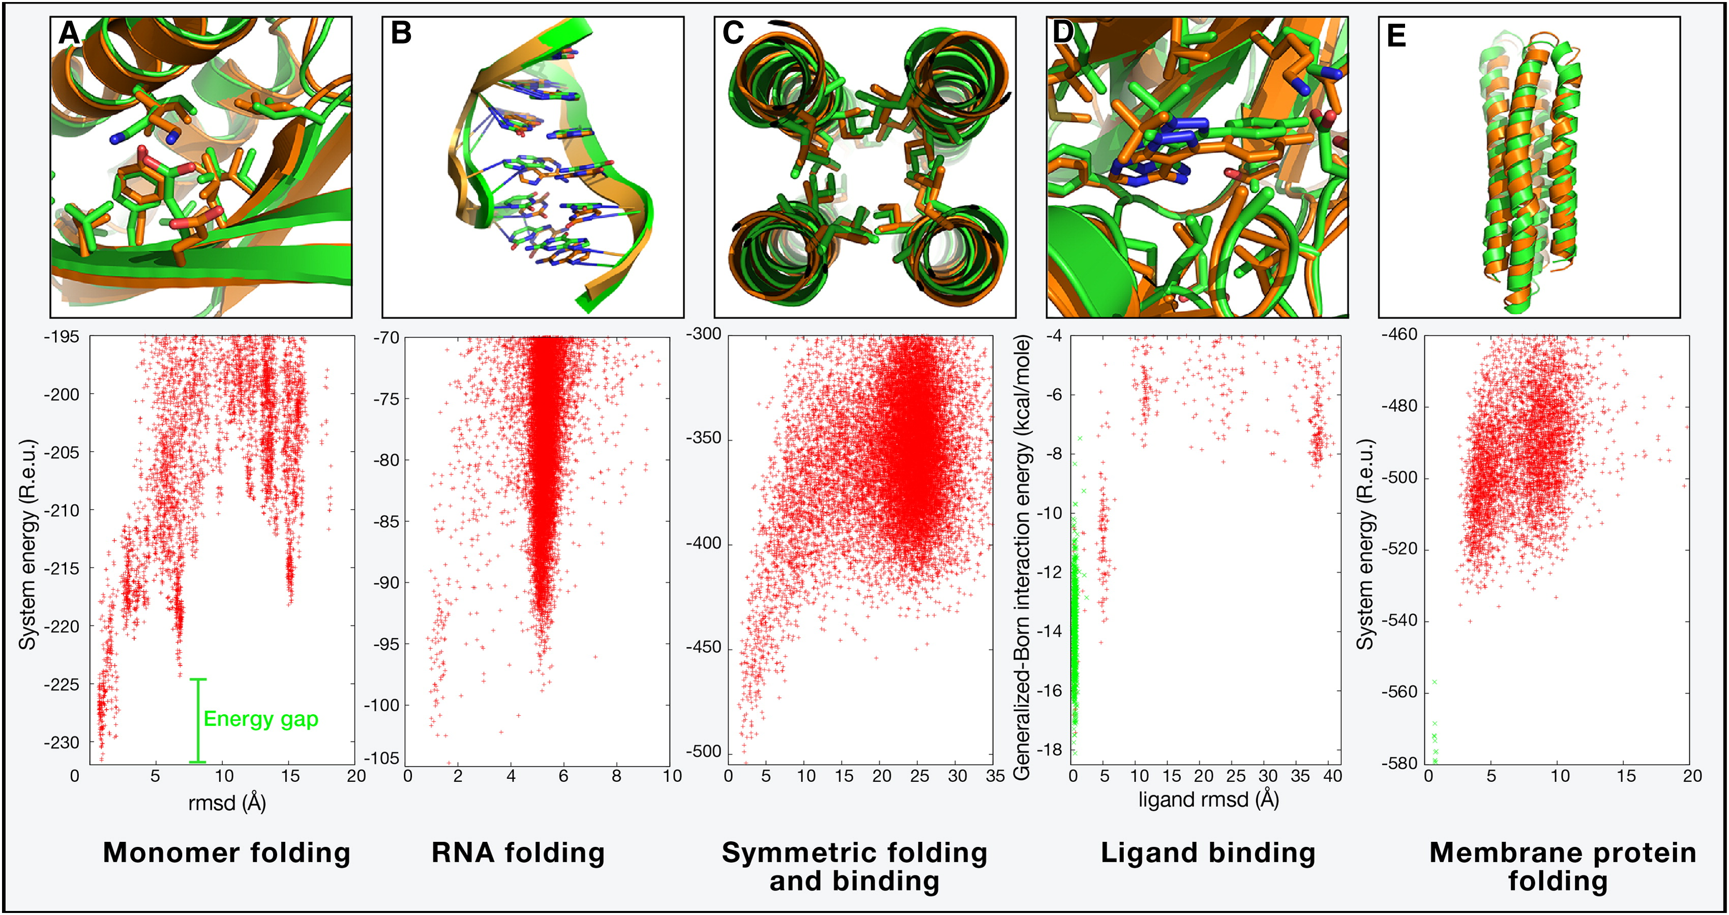

Slide 16
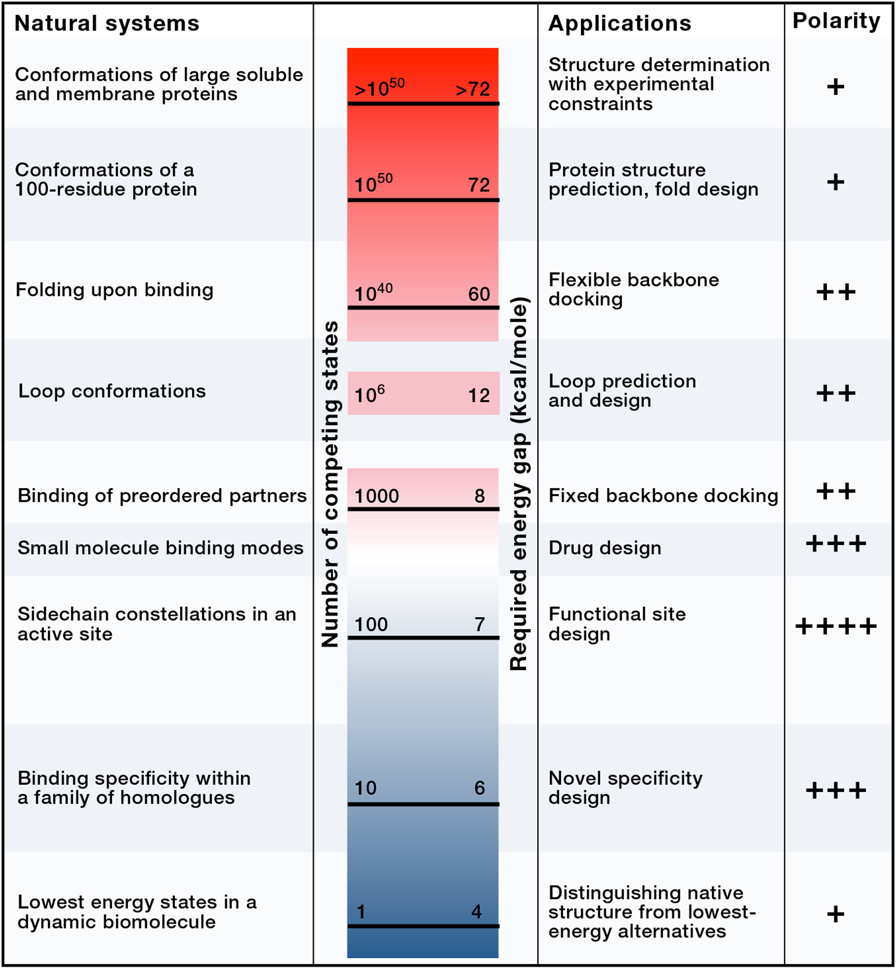
How to make it less rugged?
Restrict conformational degrees of freedom
Learn coarse-grained representations

Slide 17
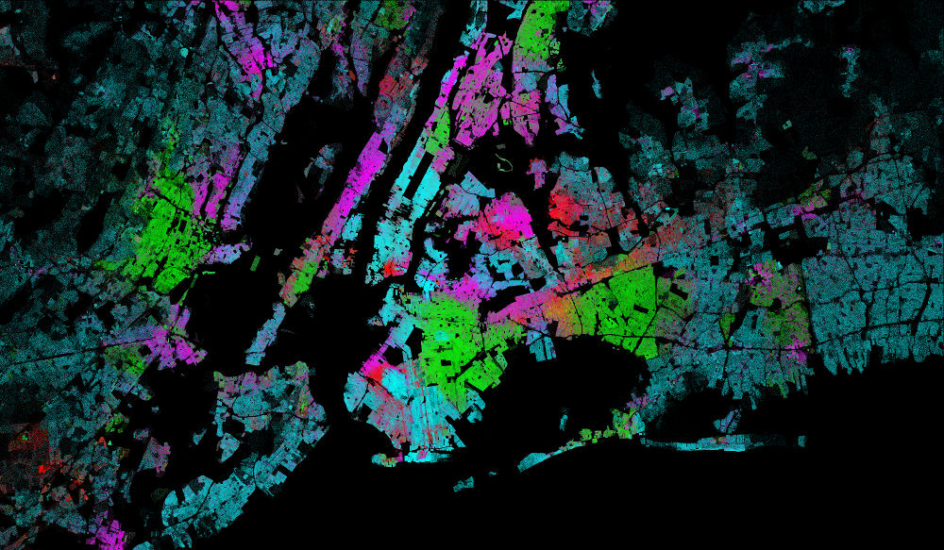
How to visualize high-dimensional spaces?
Notes:
https://datashader.org/

Slide 18
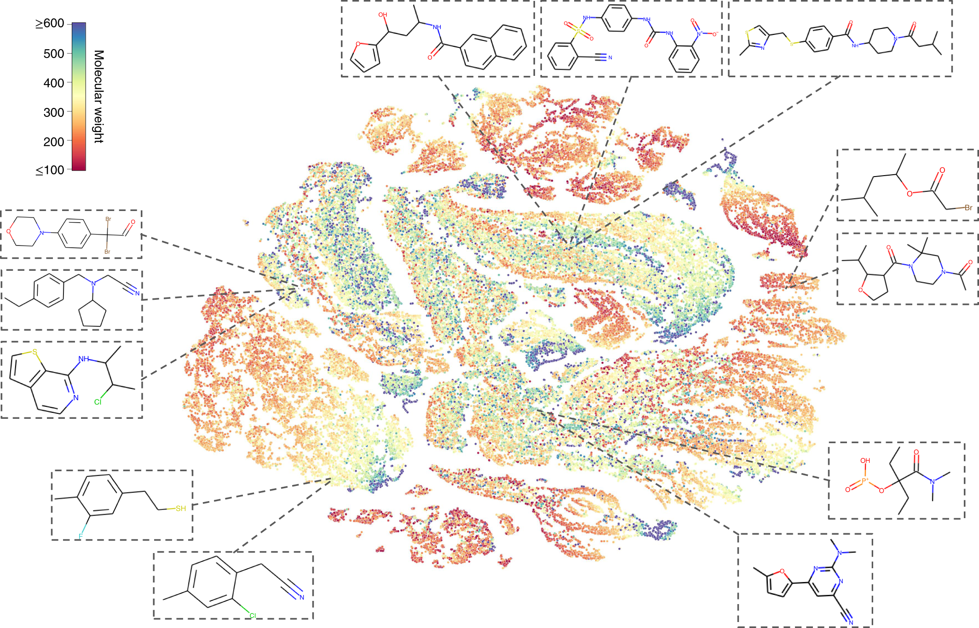
How smooth smooth are “embeddings?”

Slide 19
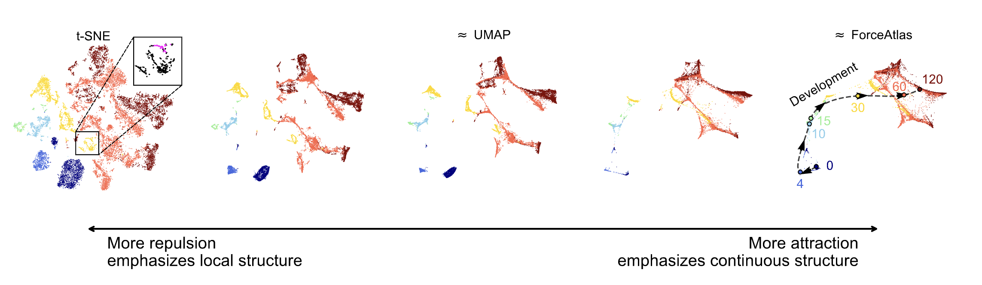
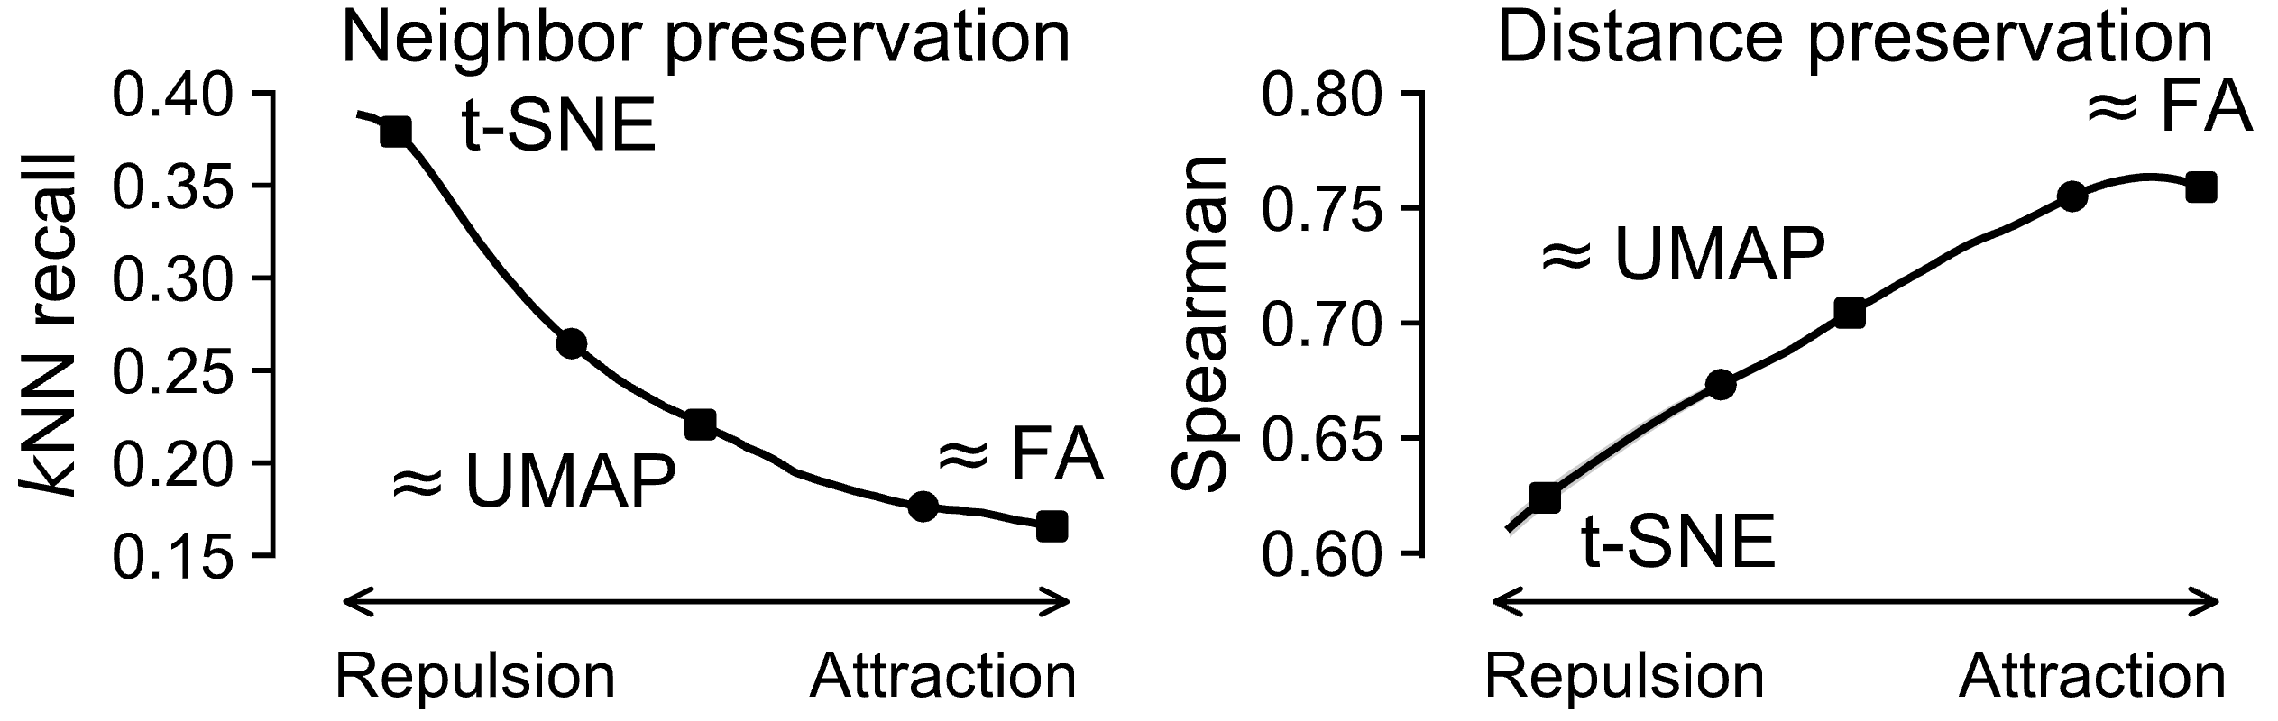
Repulsion / Attraction trade-off for non-linear embeddings
Notes:
Visualizing single-cell data with the neighbor embedding spectrum
Sebastian Damrich, Manuel V. Klockow, Philipp Berens, Fred A. Hamprecht, Dmitry Kobak
bioRxiv 2024.04.26.590867; doi: https://doi.org/10.1101/2024.04.26.590867

Slide 20
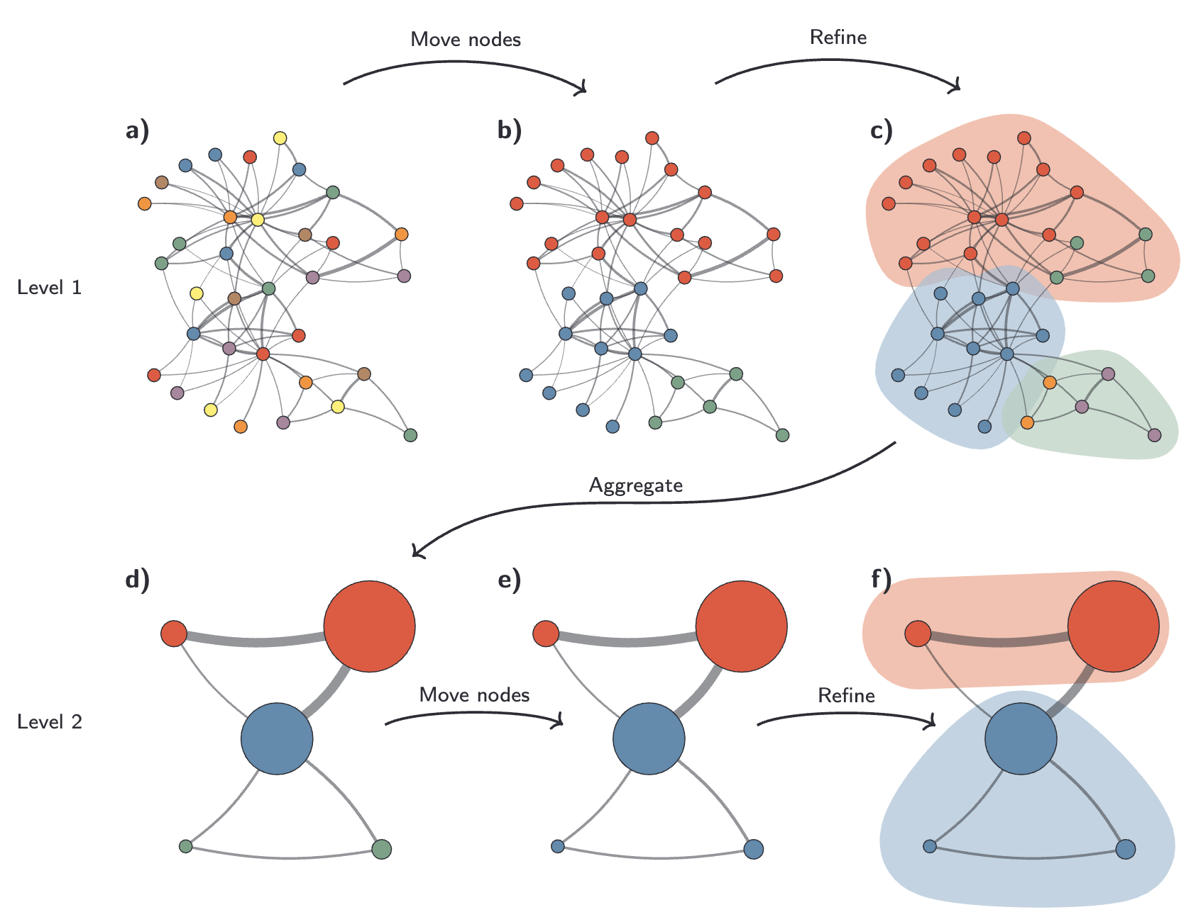
Modularity based clustering
All clustering must choose what scale of the data to emphasize
Leiden
Resolution parameter parameter controls number of clusters
Notes:
https://www.nature.com/articles/s41598-019-41695-z
Traag, V.A., Waltman, L. & van Eck, N.J. From Louvain to Leiden: guaranteeing well-connected communities. Sci Rep 9, 5233 (2019). https://doi.org/10.1038/s41598-019-41695-z

Slide 21
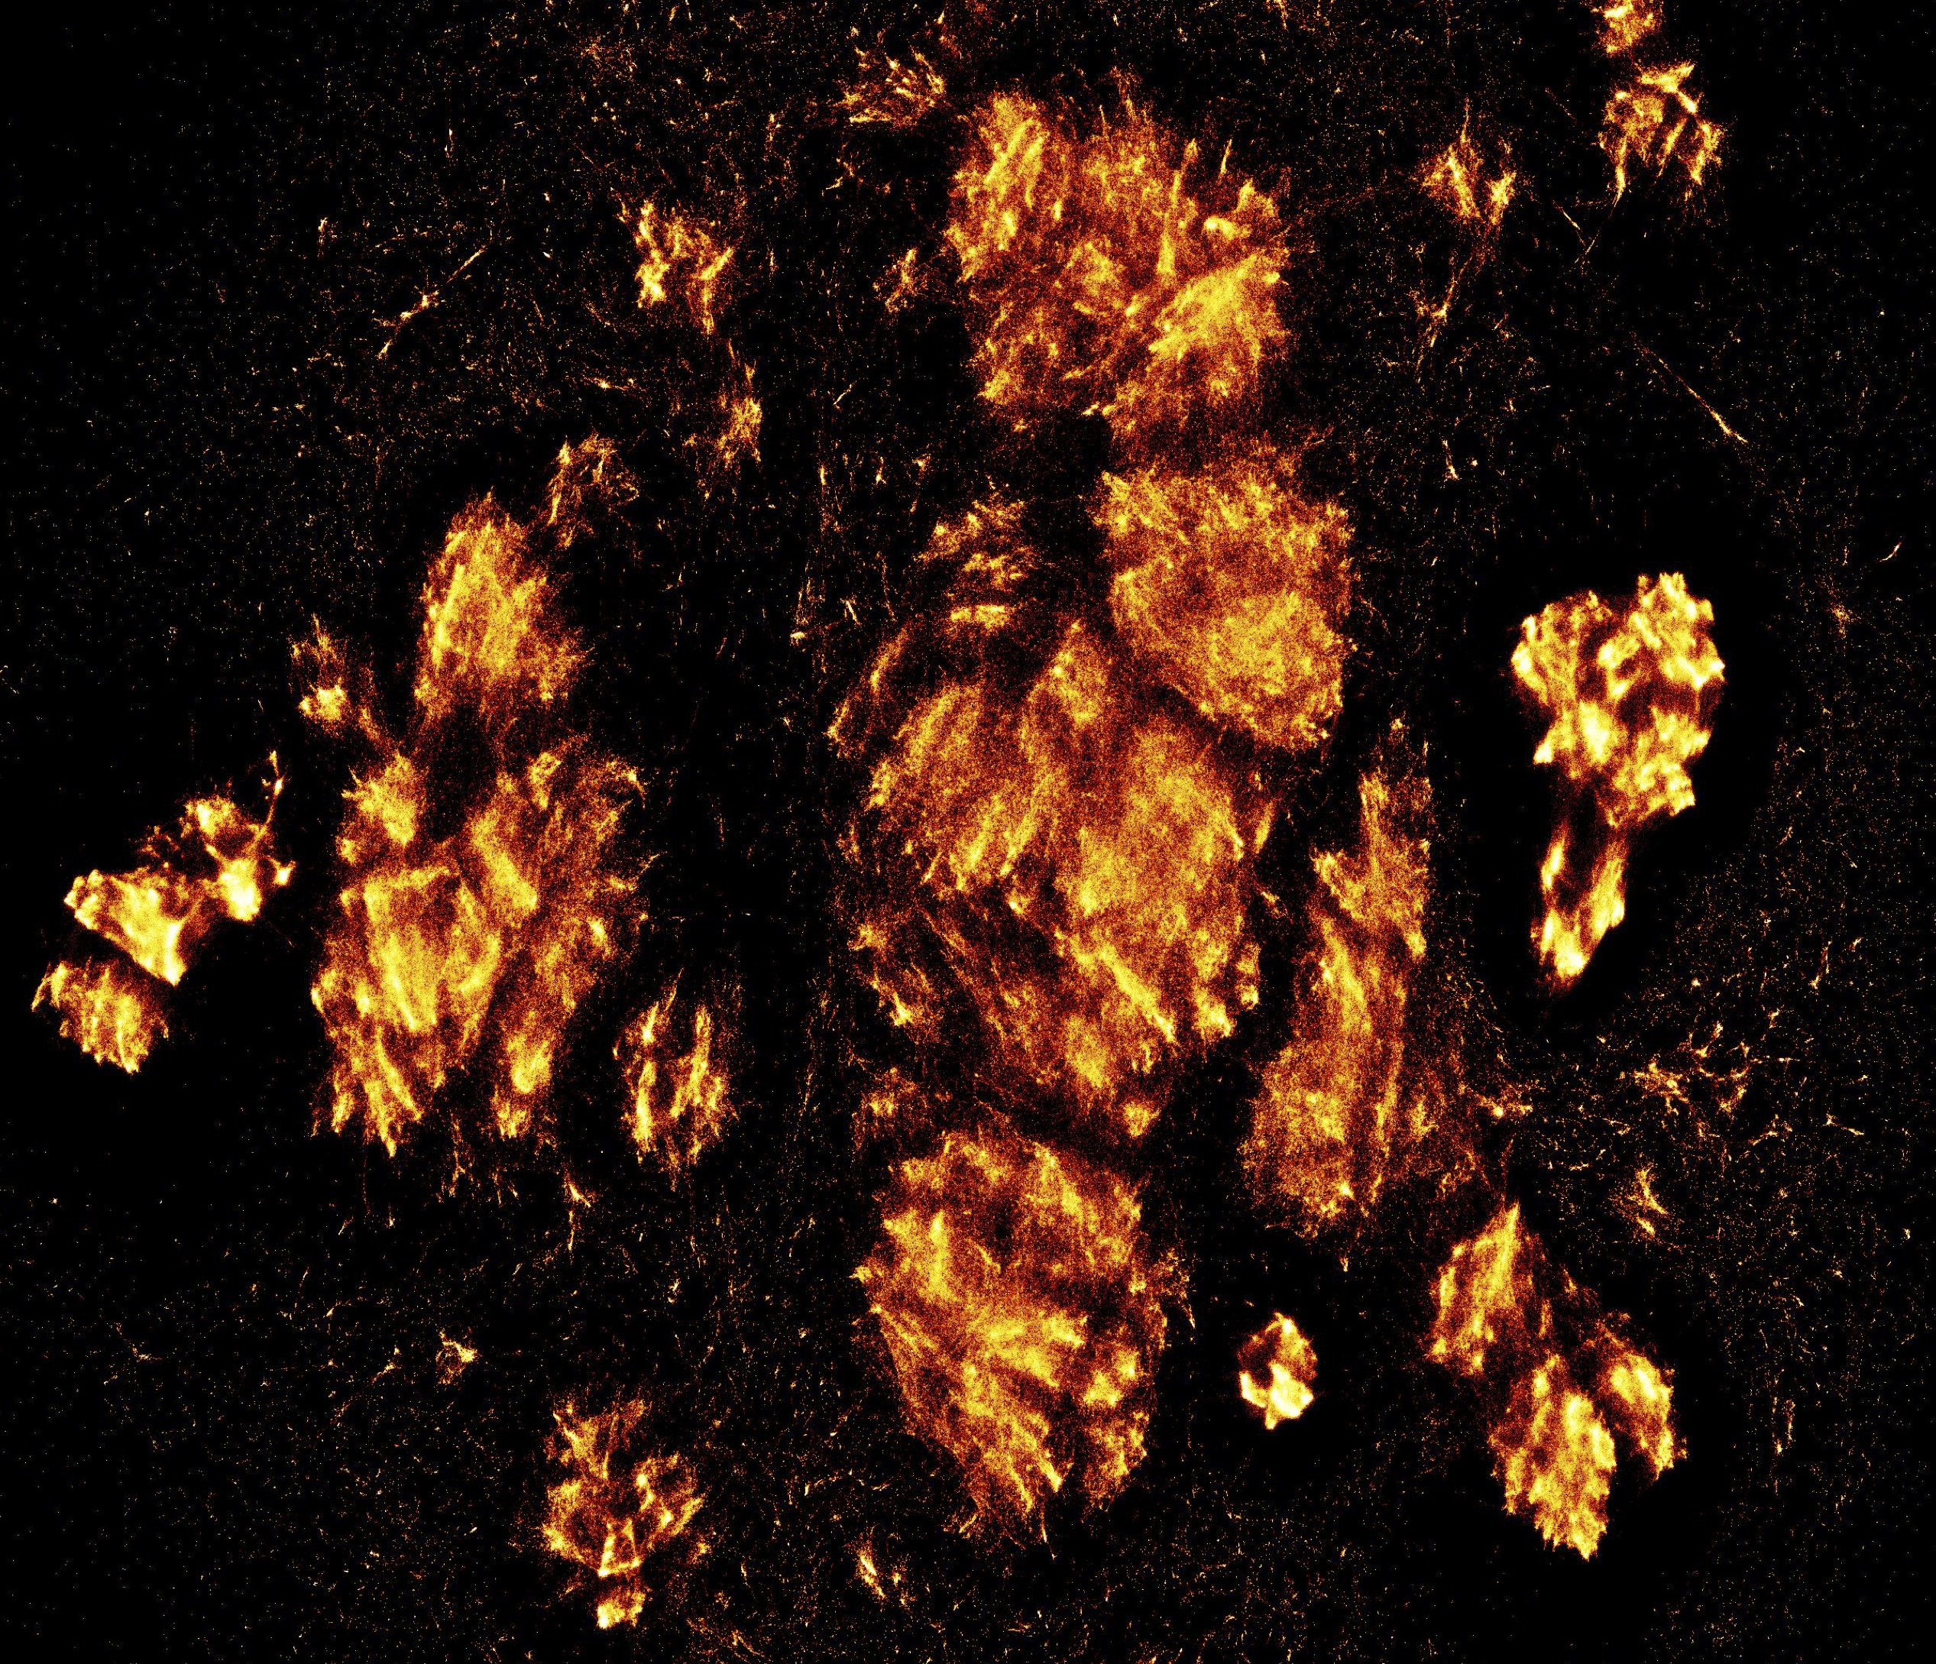
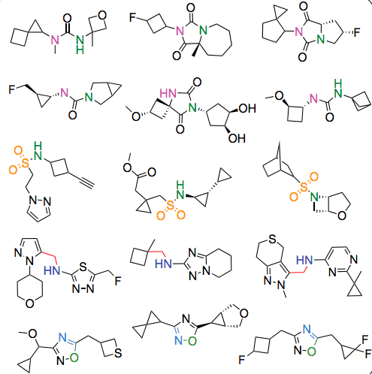
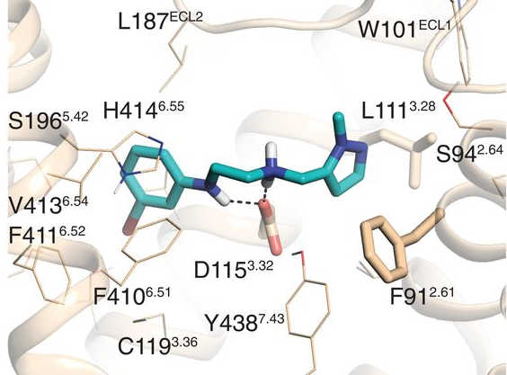
UMAP
Embedding
10 M Compounds
make-on-demand compounds
docking pose
binding energy

Slide 22
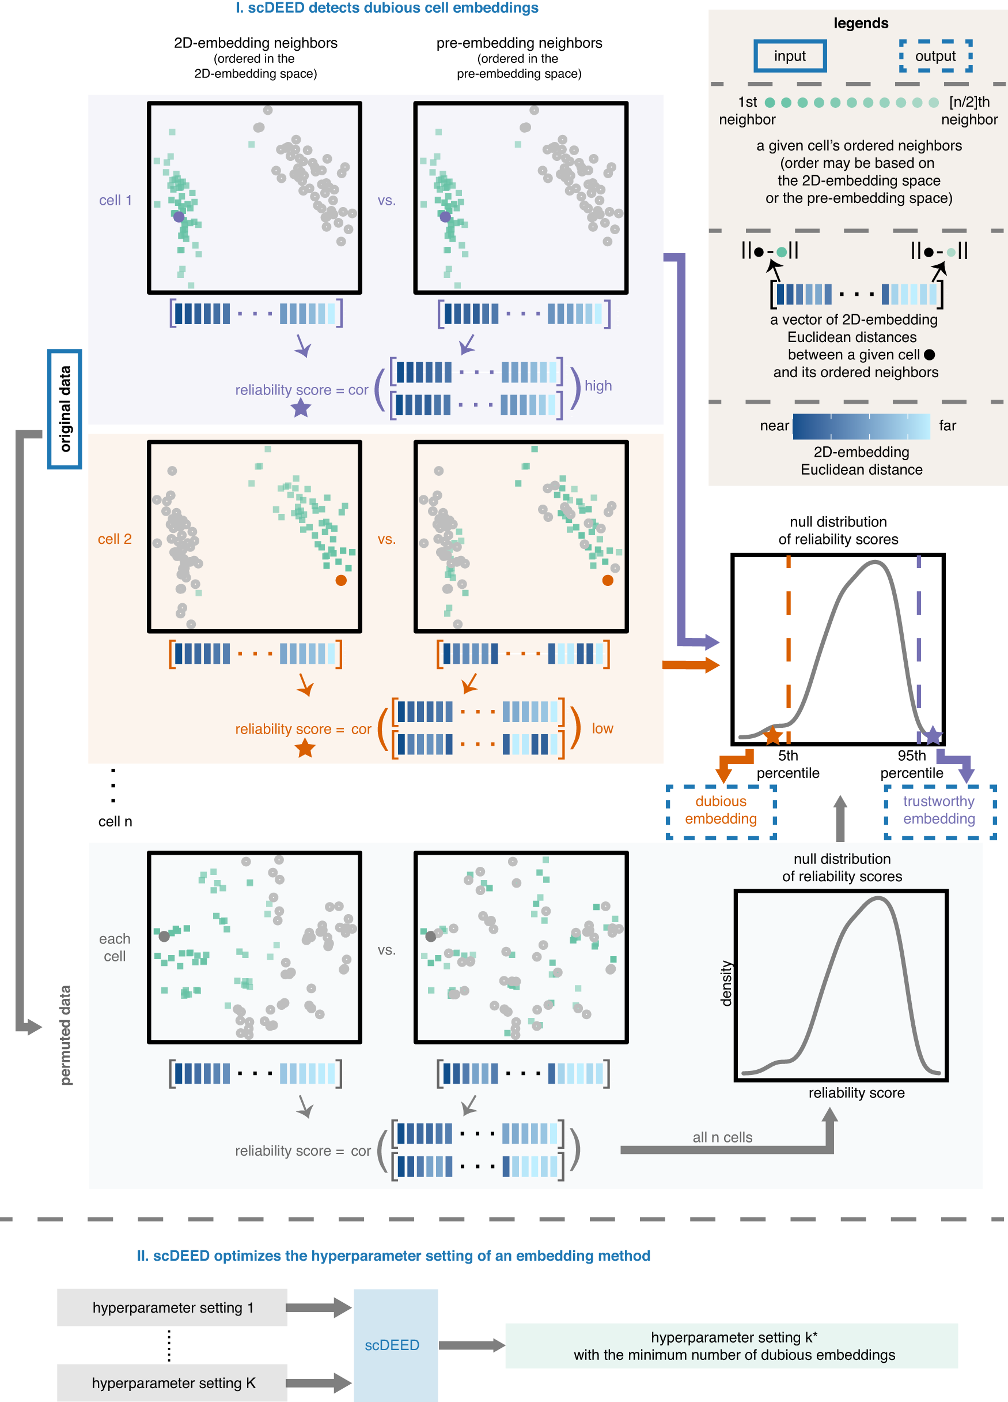
How to quantify distortion? Compare neighbors before/after transformation
scDEED
Less distortion
More distortion

Slide 23
Use permutation test to assess reliability

Slide 24
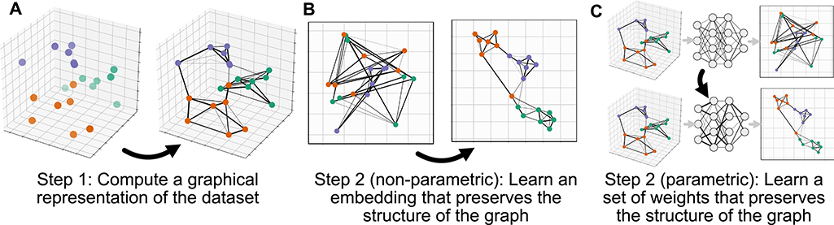
Parametric UMAP Faster, and can incorporate loss information
Notes:
https://umap-learn.readthedocs.io/en/latest/parametric_umap.html
@article{sainburg2021parametric, title={Parametric UMAP Embeddings for Representation and Semisupervised Learning}, author={Sainburg, Tim and McInnes, Leland and Gentner, Timothy Q}, journal={Neural Computation}, volume={33}, number={11}, pages={2881--2907}, year={2021}, publisher={MIT Press One Rogers Street, Cambridge, MA 02142-1209, USA journals-info~…} }

Slide 25
Parametric UMAP Faster, and can incorporate loss information
Notes:
https://umap-learn.readthedocs.io/en/latest/parametric_umap.html
@article{sainburg2021parametric, title={Parametric UMAP Embeddings for Representation and Semisupervised Learning}, author={Sainburg, Tim and McInnes, Leland and Gentner, Timothy Q}, journal={Neural Computation}, volume={33}, number={11}, pages={2881--2907}, year={2021}, publisher={MIT Press One Rogers Street, Cambridge, MA 02142-1209, USA journals-info~…} }

Slide 26
Parametric UMAP Faster, and can incorporate loss information
Notes:
https://umap-learn.readthedocs.io/en/latest/parametric_umap.html
@article{sainburg2021parametric, title={Parametric UMAP Embeddings for Representation and Semisupervised Learning}, author={Sainburg, Tim and McInnes, Leland and Gentner, Timothy Q}, journal={Neural Computation}, volume={33}, number={11}, pages={2881--2907}, year={2021}, publisher={MIT Press One Rogers Street, Cambridge, MA 02142-1209, USA journals-info~…} }

Slide 27
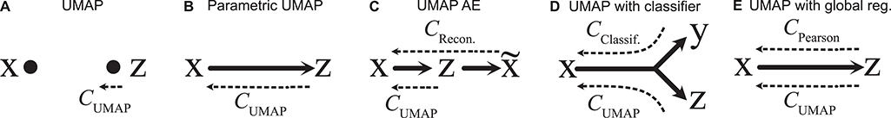
Parametric UMAP Faster, and can incorporate loss information
Notes:
https://umap-learn.readthedocs.io/en/latest/parametric_umap.html
@article{sainburg2021parametric, title={Parametric UMAP Embeddings for Representation and Semisupervised Learning}, author={Sainburg, Tim and McInnes, Leland and Gentner, Timothy Q}, journal={Neural Computation}, volume={33}, number={11}, pages={2881--2907}, year={2021}, publisher={MIT Press One Rogers Street, Cambridge, MA 02142-1209, USA journals-info~…} }

Slide 28
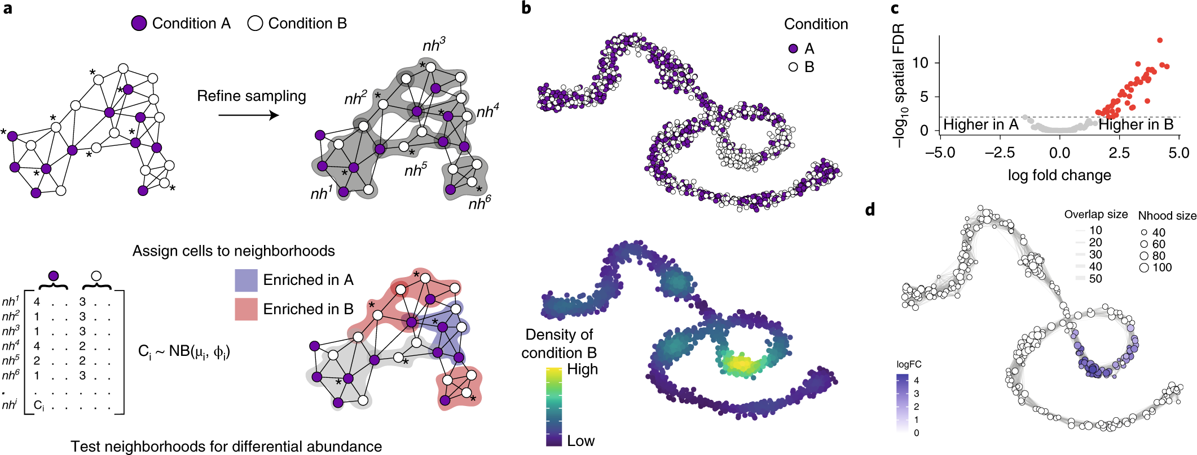
How to test for local enrichment? Key-challenge => multiple hypothesis testing
MILO
Notes:
Dann, E., Henderson, N.C., Teichmann, S.A. et al. Differential abundance testing on single-cell data using k-nearest neighbor graphs. Nat Biotechnol 40, 245–253 (2022). https://doi.org/10.1038/s41587-021-01033-z
https://www.nature.com/articles/s41587-021-01033-z

Slide 29
How to test for local enrichment? Key-challenge => multiple hypothesis testing
MILO
Notes:
Dann, E., Henderson, N.C., Teichmann, S.A. et al. Differential abundance testing on single-cell data using k-nearest neighbor graphs. Nat Biotechnol 40, 245–253 (2022). https://doi.org/10.1038/s41587-021-01033-z
https://www.nature.com/articles/s41587-021-01033-z

Slide 30
How to test for local enrichment? Key-challenge => multiple hypothesis testing
MILO
Notes:
Dann, E., Henderson, N.C., Teichmann, S.A. et al. Differential abundance testing on single-cell data using k-nearest neighbor graphs. Nat Biotechnol 40, 245–253 (2022). https://doi.org/10.1038/s41587-021-01033-z
https://www.nature.com/articles/s41587-021-01033-z

Slide 31
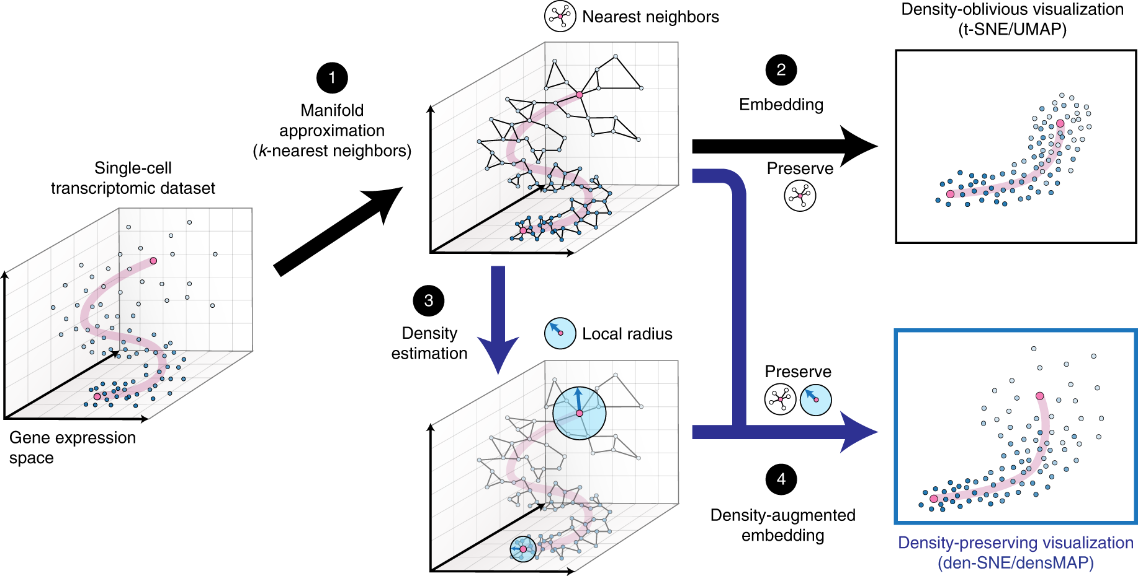
Preserve local density By direct optimization
densUMAP
Notes:
Narayan, A., Berger, B. & Cho, H. Assessing single-cell transcriptomic variability through density-preserving data visualization. Nat Biotechnol 39, 765–774 (2021). https://doi.org/10.1038/s41587-020-00801-7

Slide 32
Preserve local density By direct optimization
densUMAP
Notes:
Narayan, A., Berger, B. & Cho, H. Assessing single-cell transcriptomic variability through density-preserving data visualization. Nat Biotechnol 39, 765–774 (2021). https://doi.org/10.1038/s41587-020-00801-7

Slide 33
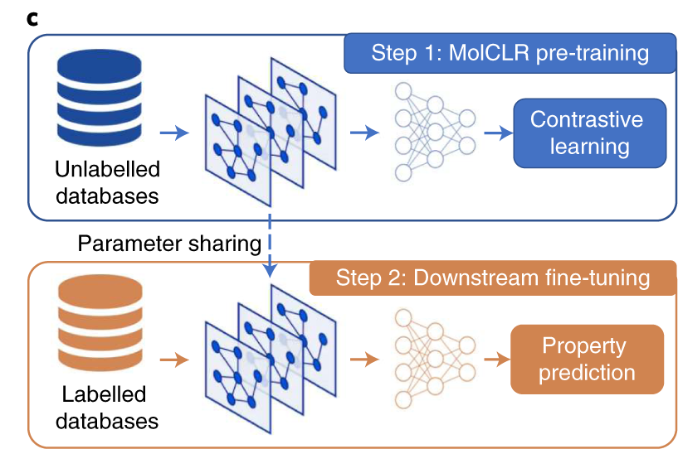
Self supervised representation learning
(Wang, 2021)
Notes:
Molecular Contrastive Learning of Representations via Graph Neural Networks
Yuyang Wang, Jianren Wang, Zhonglin Cao, Amir Barati Farimani

Slide 34
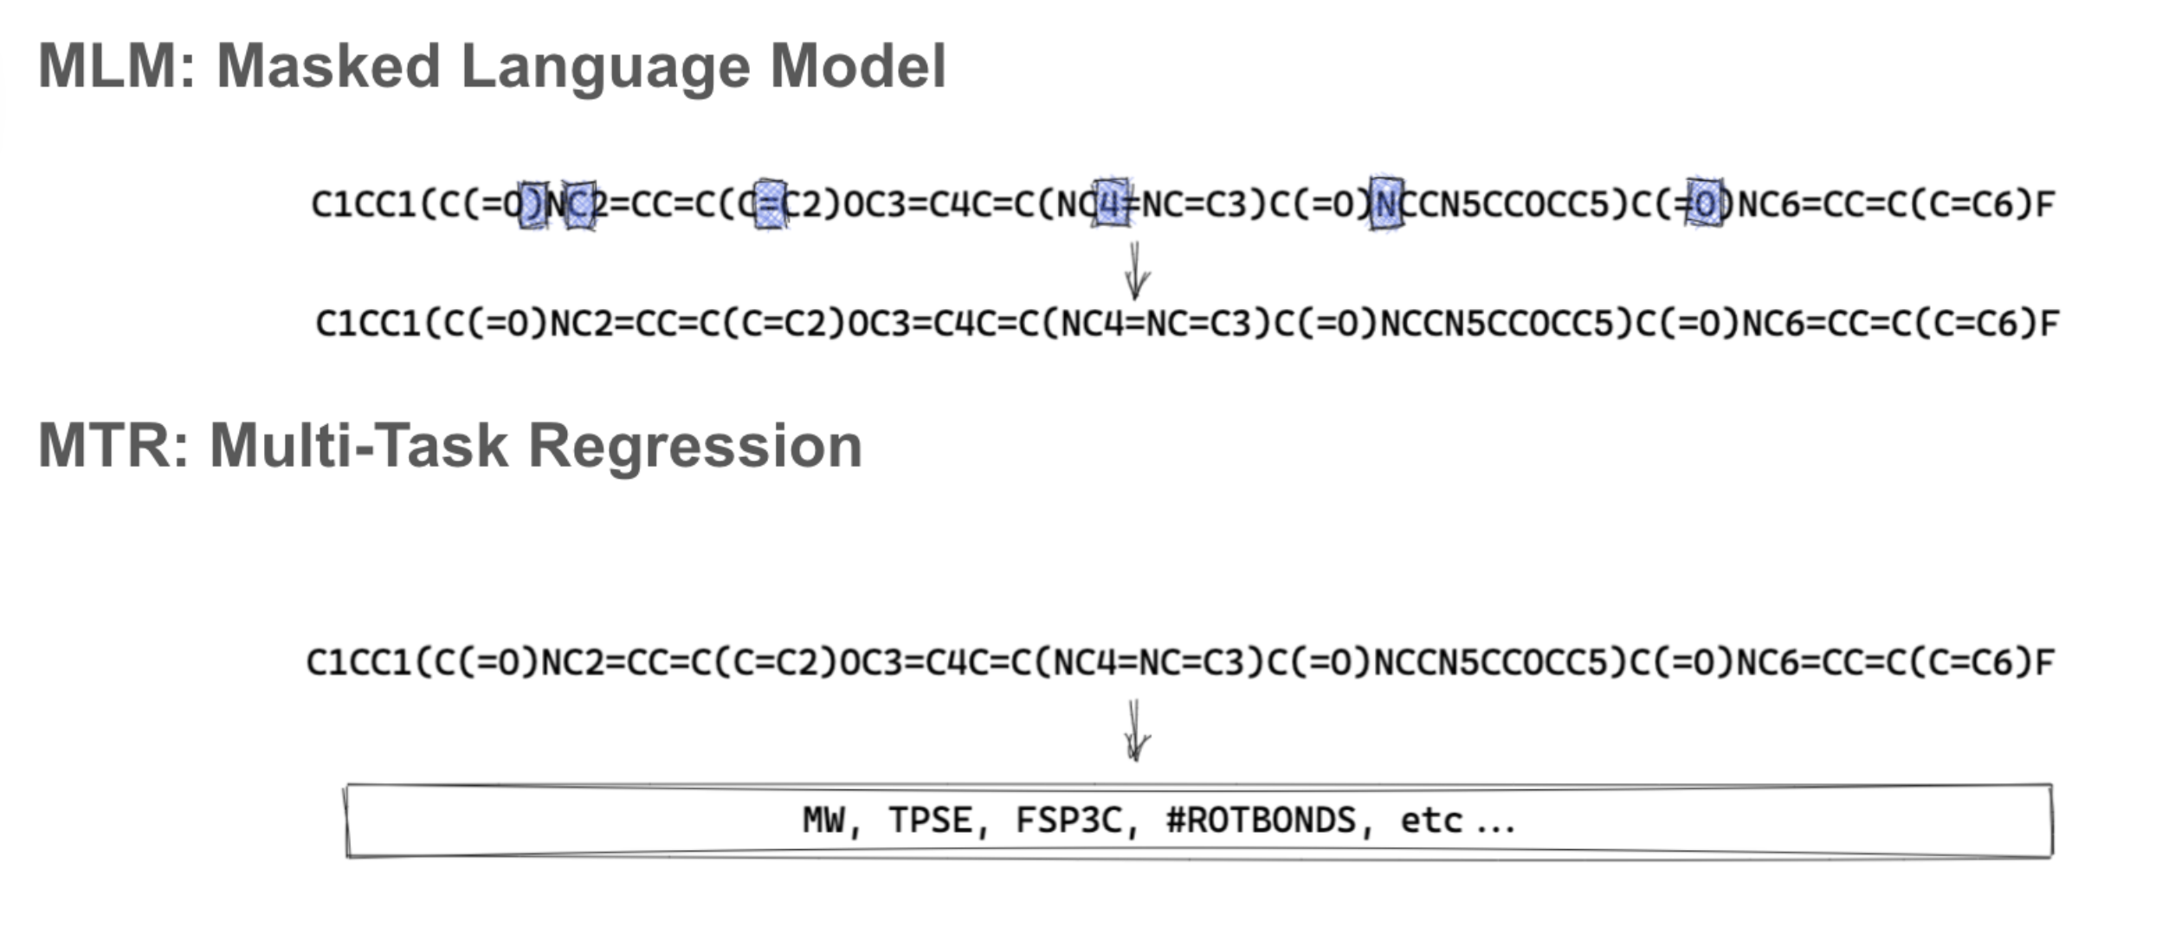
Notes:
https://arxiv.org/abs/2209.01712
[Submitted on 5 Sep 2022]
ChemBERTa-2: Towards Chemical Foundation Models
Walid Ahmad, Elana Simon, Seyone Chithrananda, Gabriel Grand, Bharath Ramsundar

Slide 35
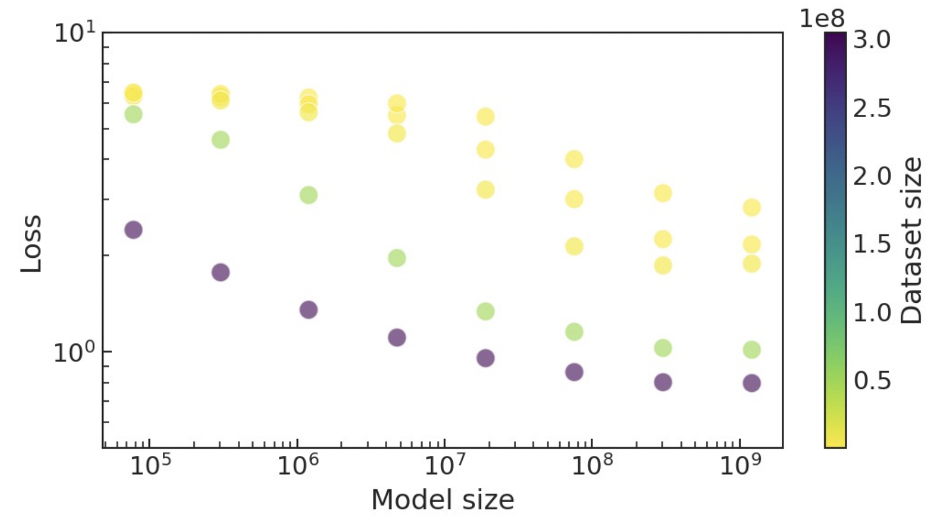
Chemical language models can scale to high-capacity
ChemGPT
1.2 Billion parameters
10 million molecules (PubChem)
Task: mask and predict next token
(Frey, et al., 2022)
Notes:
Neural Scaling of Deep Chemical Models
Nathan C. Frey, Ryan Soklaski , Simon Axelrod, Siddharth Samsi, Rafael Gomez-Bombarelli, Connor W. Coley and Vijay Gadepally
https://chemrxiv.org/engage/chemrxiv/article-details/627bddd544bdd532395fb4b5

Slide 36
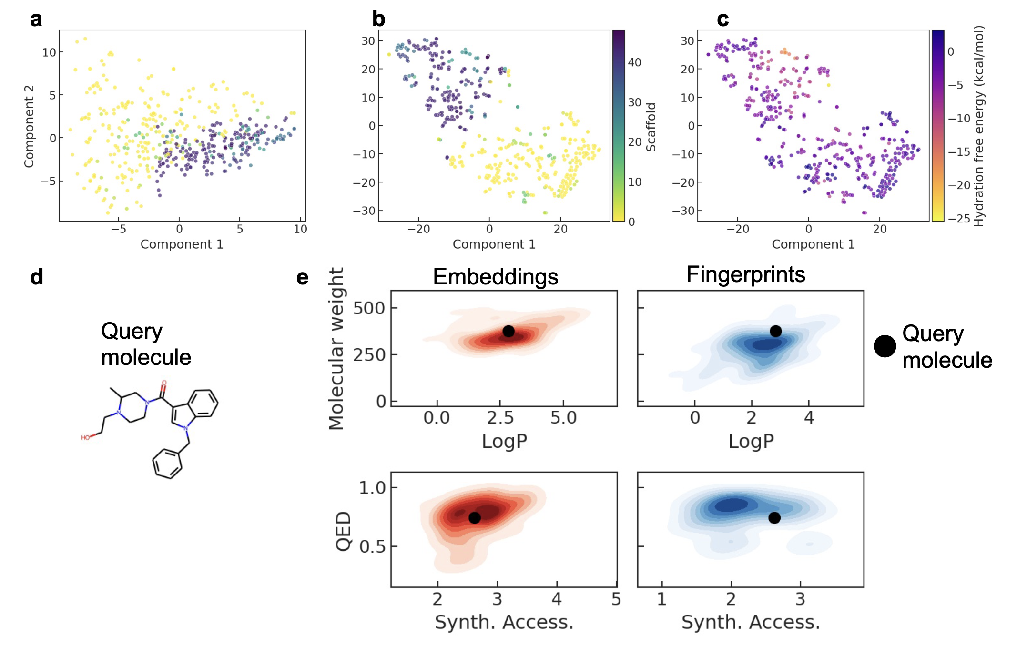
ChemGPT can learn meaningful representations

Slide 37
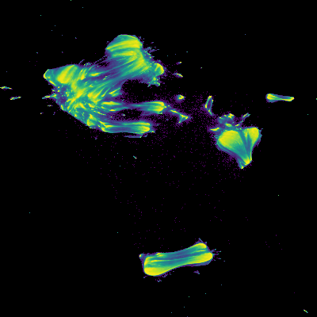
UMAP Embedding 14 million molecules
ZINC In-stock
ChEMBL27
Directory of useful decoys
Smiles -> SELFIES
Streaming PCA 648 -> 100 dimensions
Embed random 2 million subset (limited by memory)
Use Cosine similarity
Re-embed all molecules

Slide 38
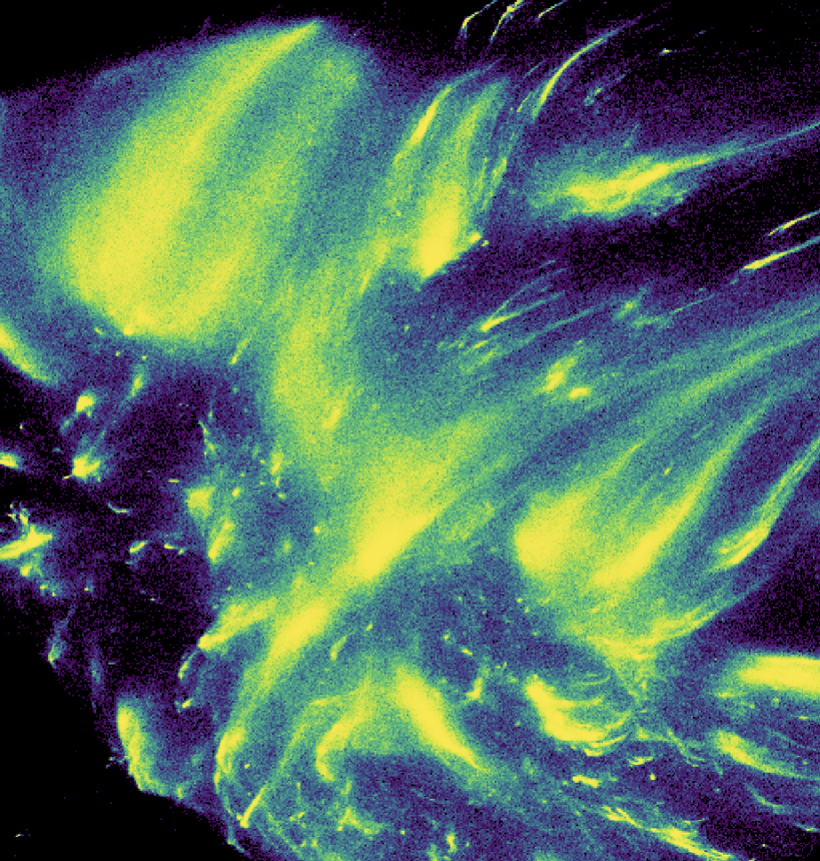

Slide 39
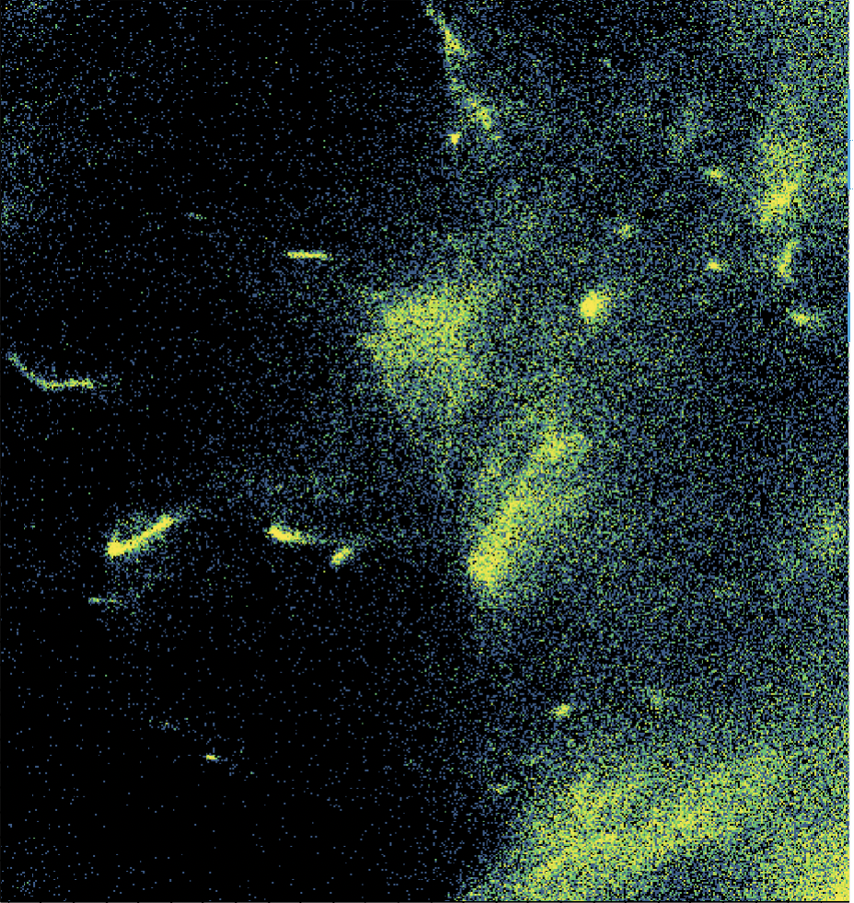

Slide 40
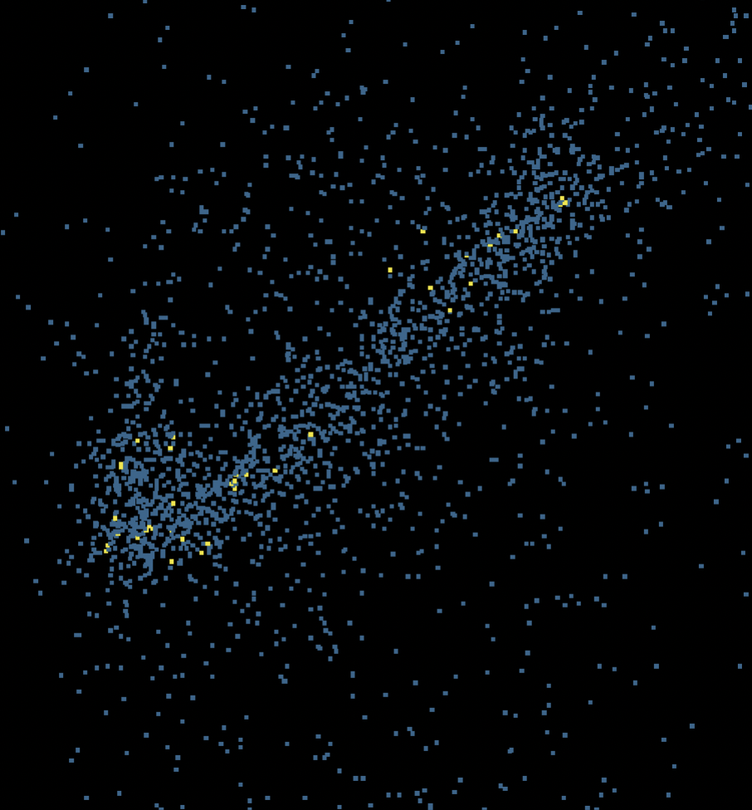

Slide 41
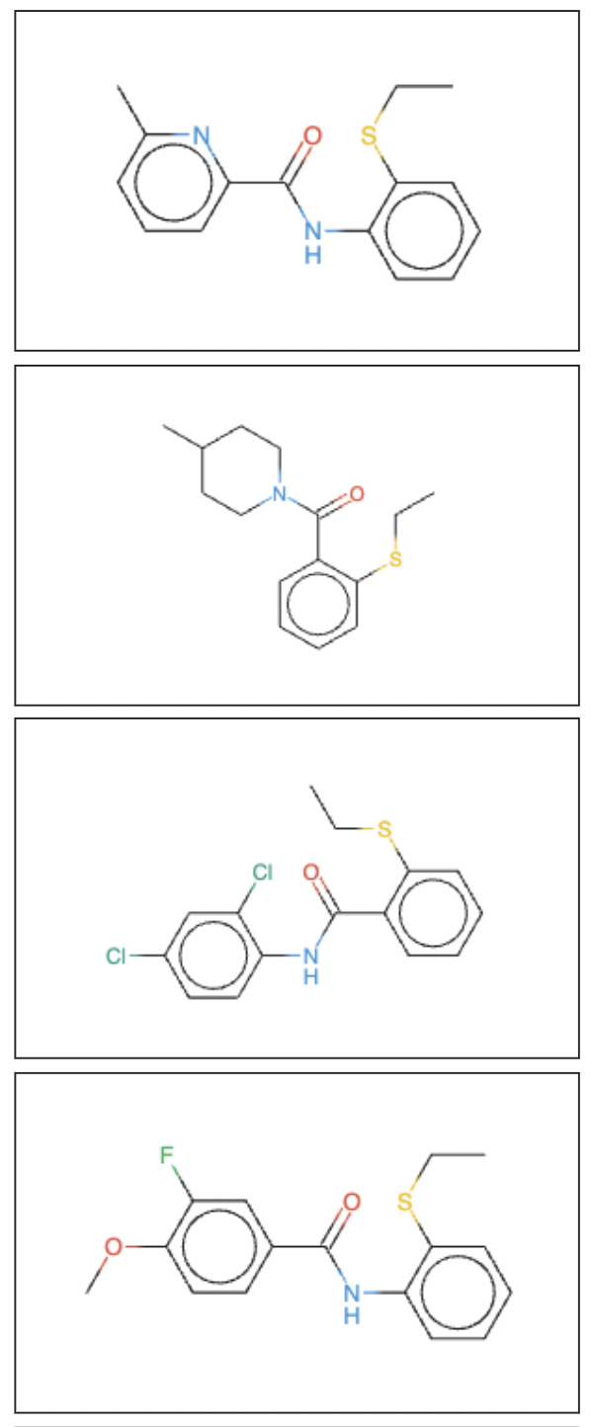

Slide 43
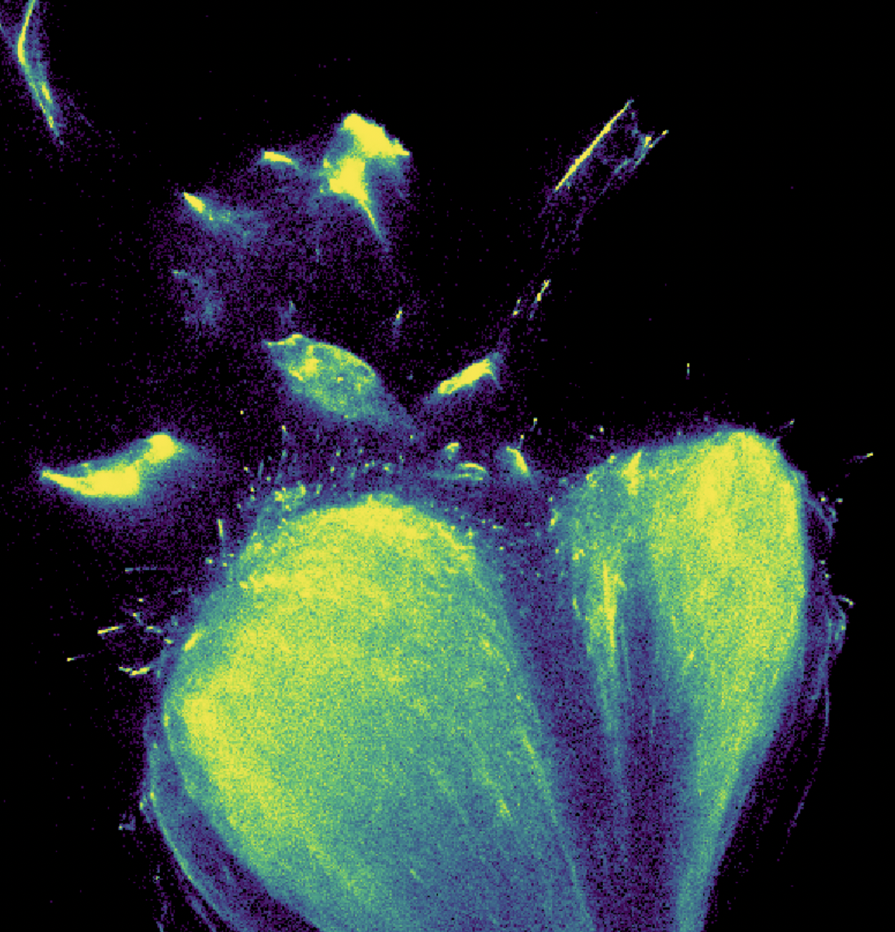

Slide 44
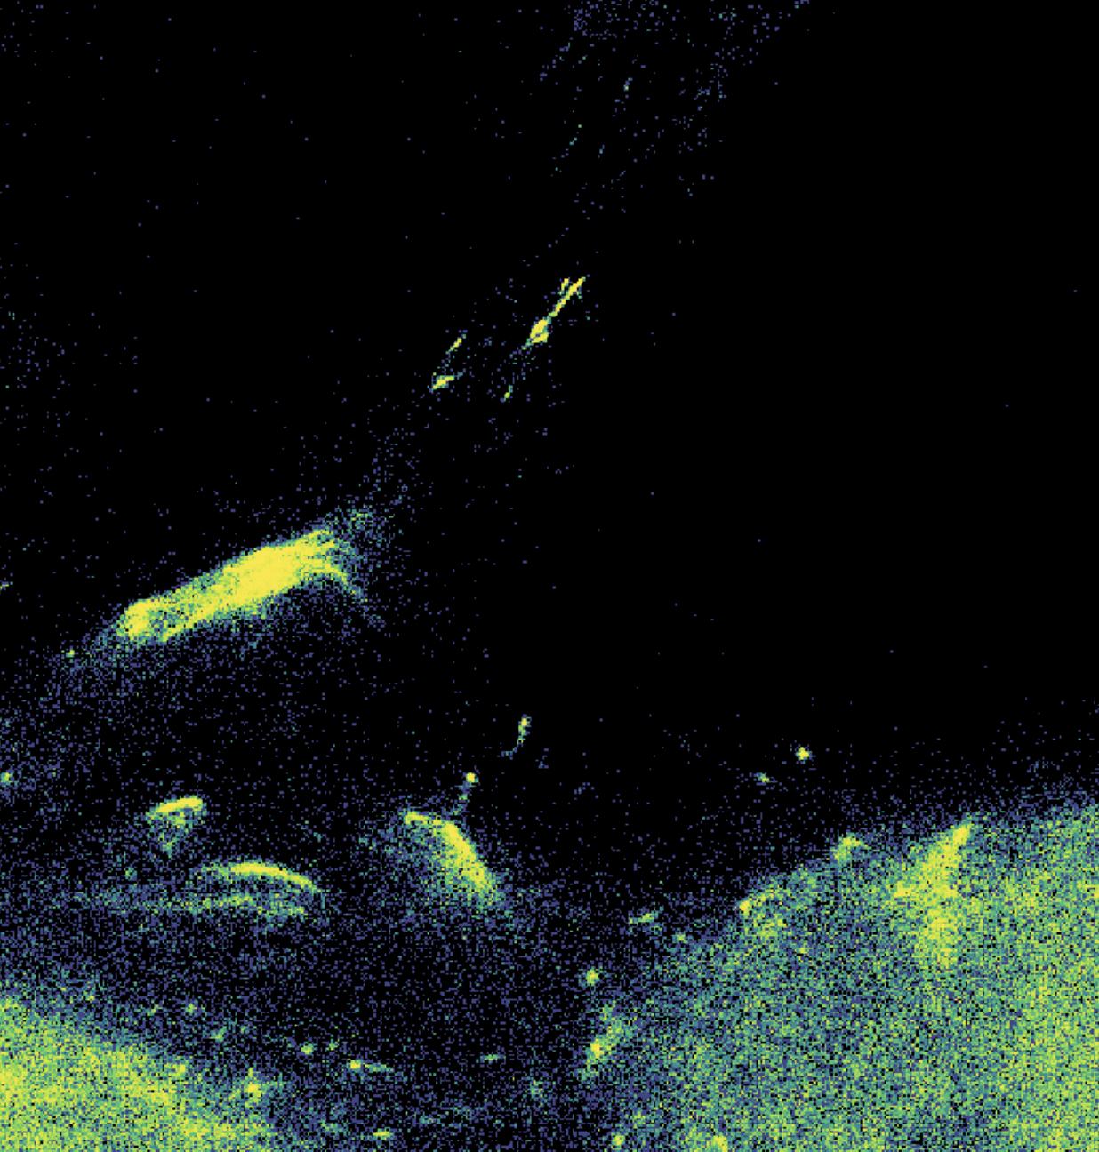

Slide 45
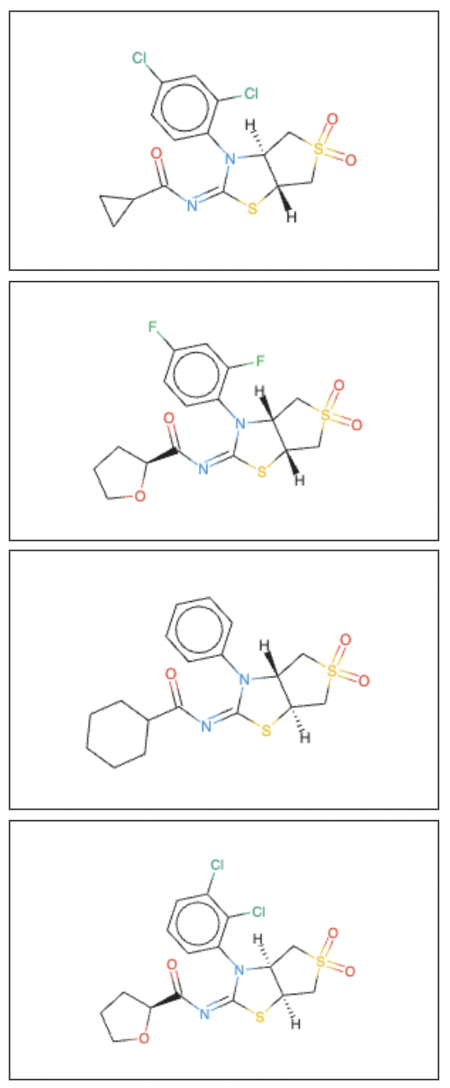

Slide 46
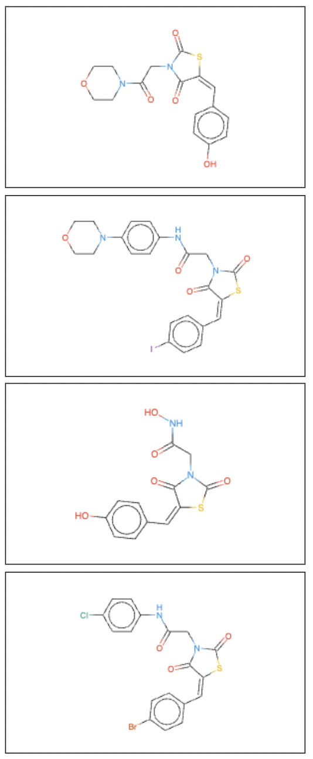

Slide 47
How does ECFP4 vs ChemGPT organize med-chem tested ligands for a target?
KCNQ family of potassium channels
Regulate tonic neuronal activity

Slide 48
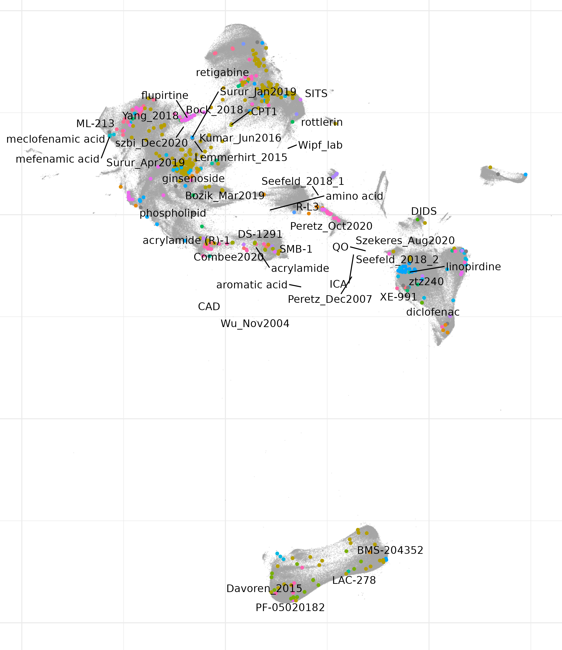

Slide 49
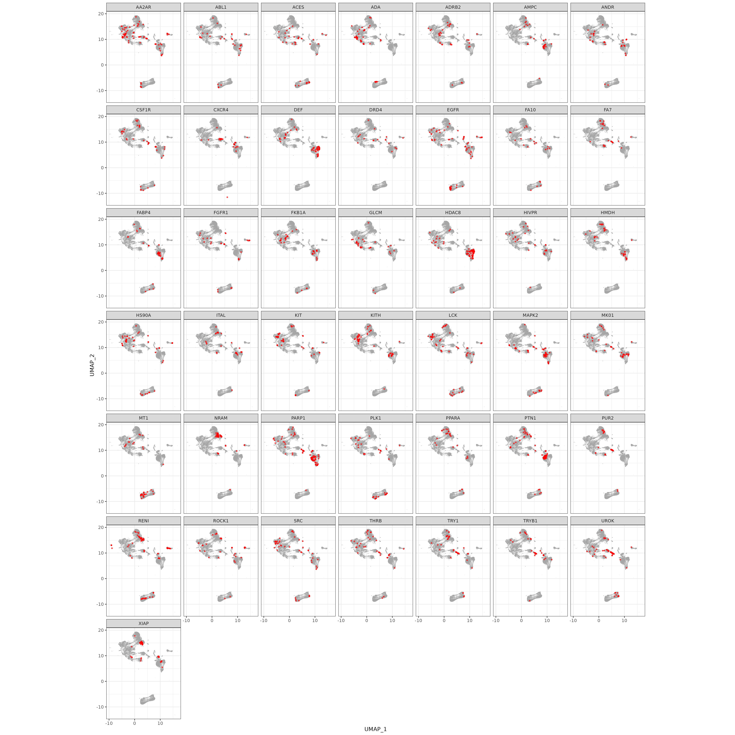
ChemGPT organization of DUDE-Z target ligand

Slide 50
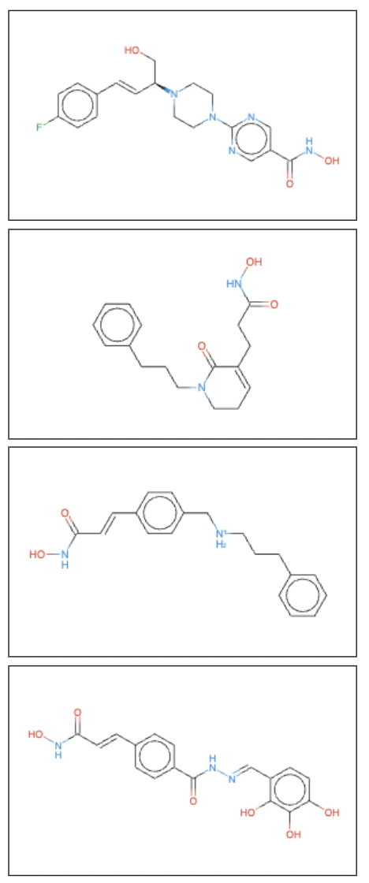
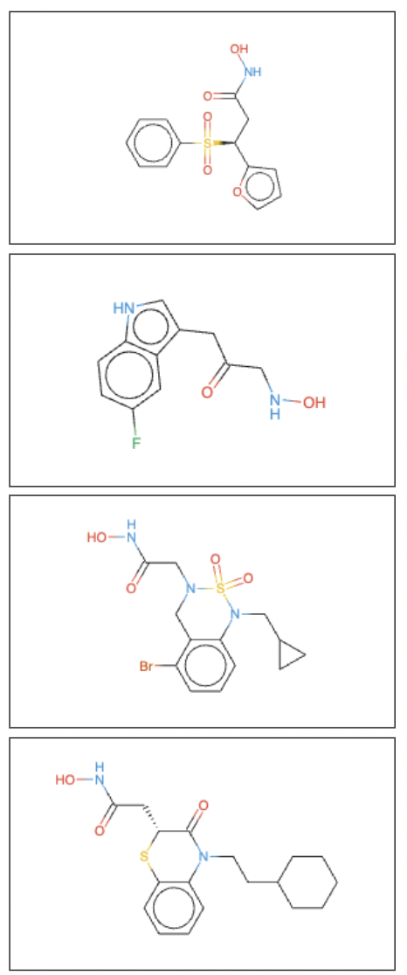
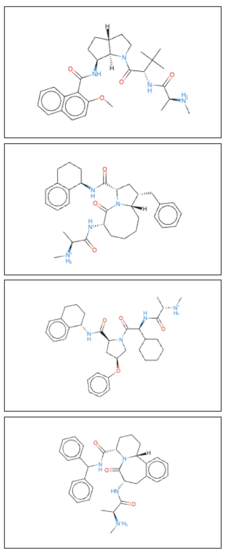
Histone deacetylase 8
0.99
0.68
1.02
X-linked inhibitor of apoptosis
Peptide deformylase

